Slide 1

Human memory systems in language education
Sebastian Lesniewski
IATEFL 2021

Slide 2
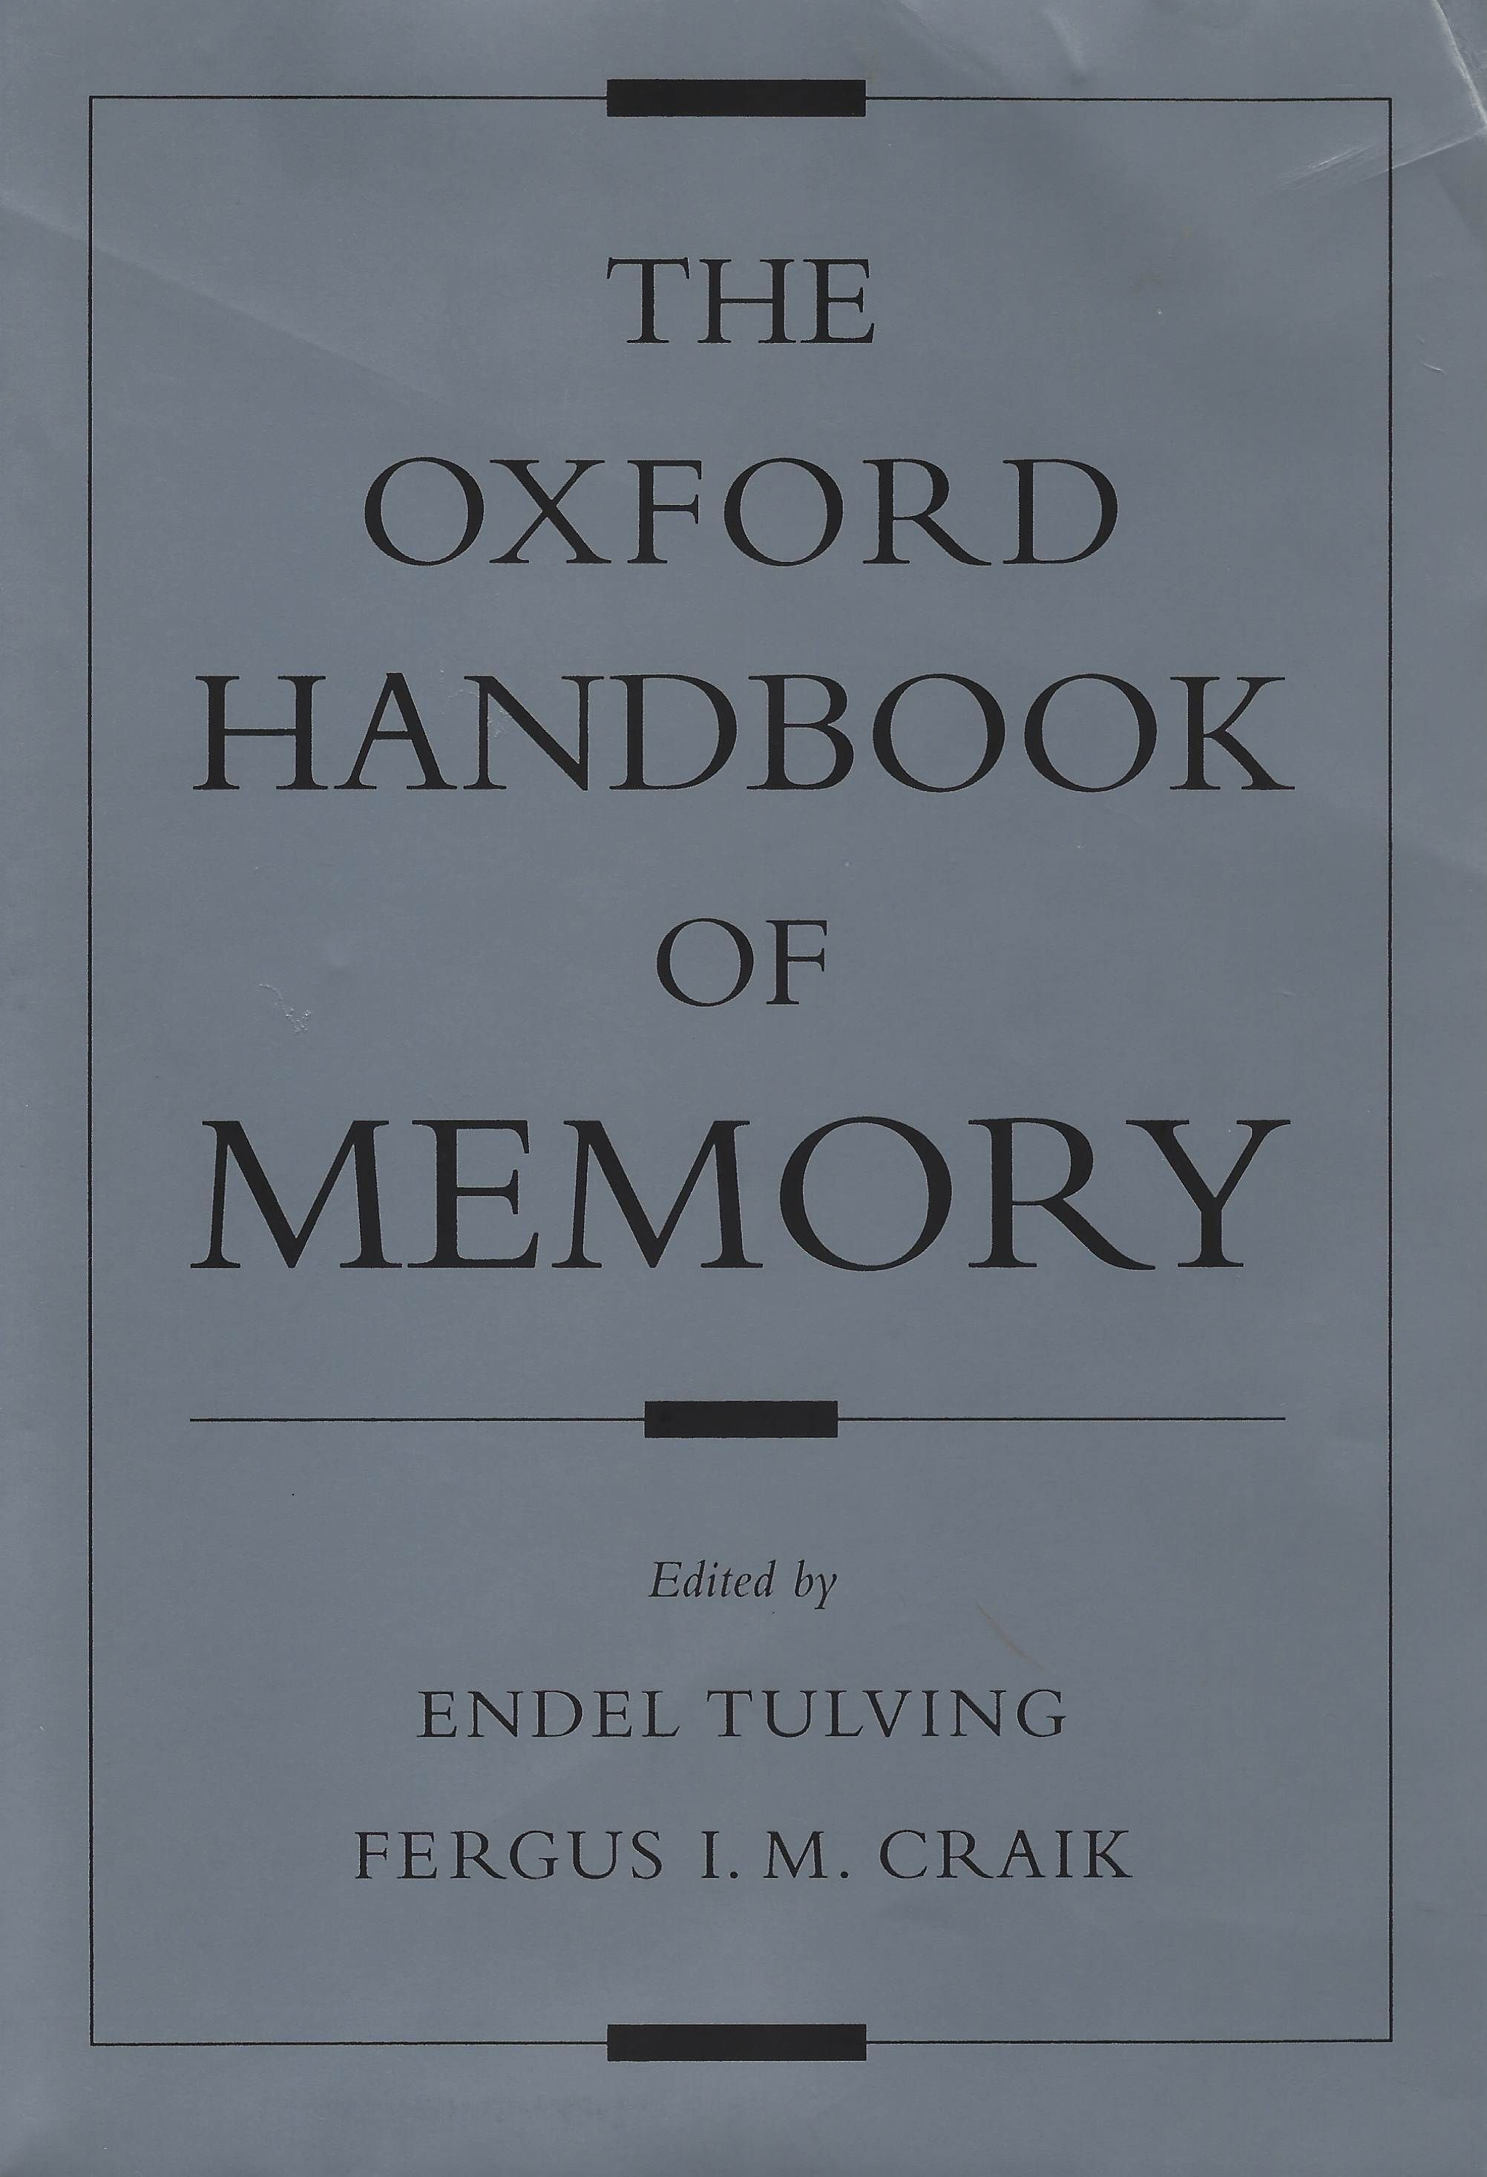
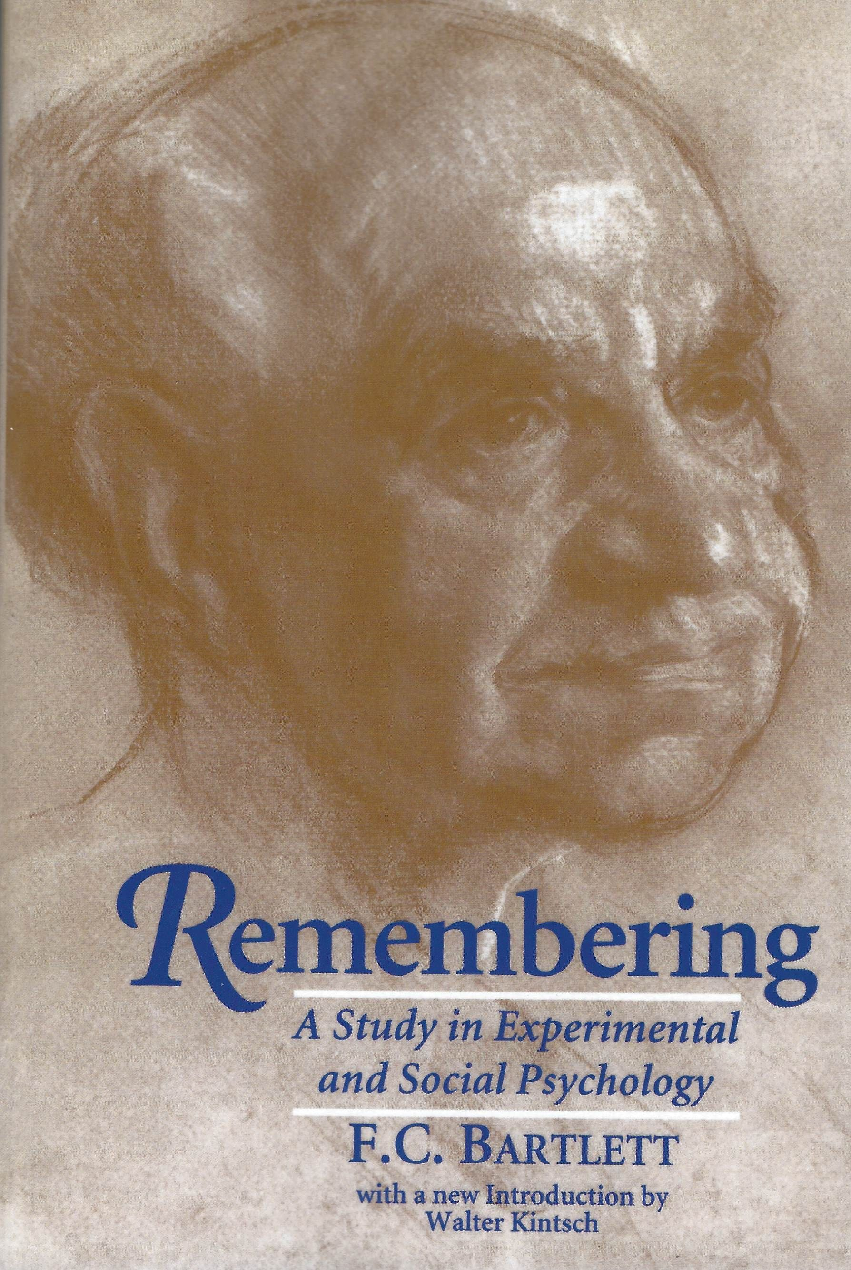
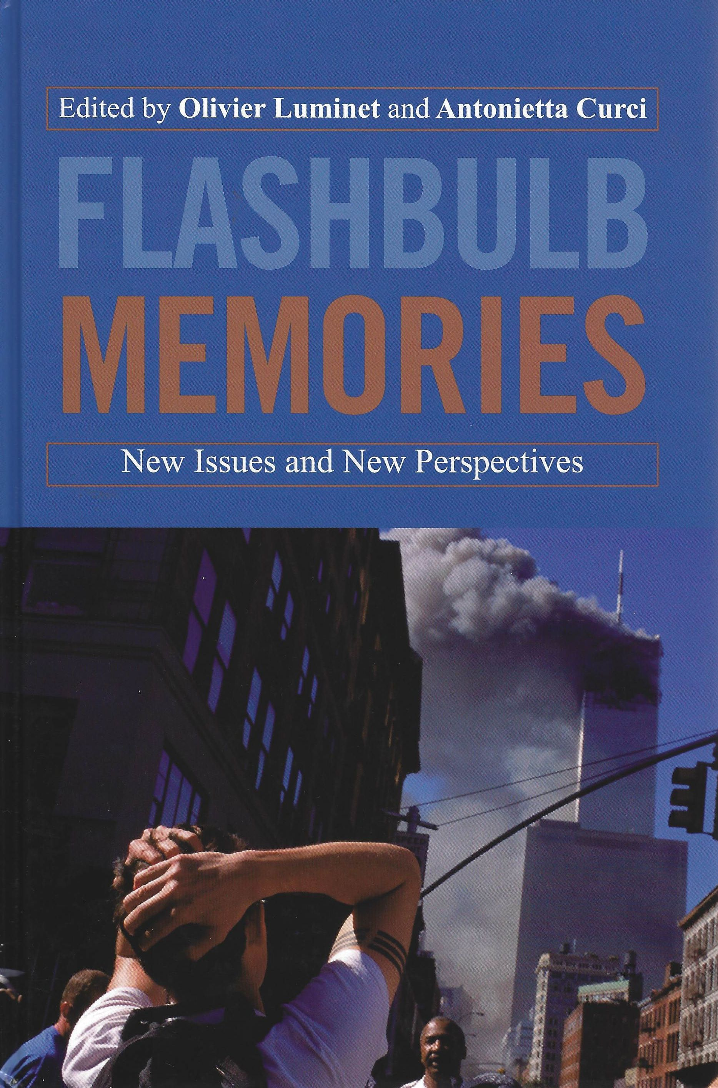
Noice, H., & Noice, T. (1996). Two approaches to learning a theatrical script. Memory, 4(1), 1-17.
Noice, H., & Noice, T. (2006). What Studies of Actors and Acting CanTell Us About Memory and Cognitive Functioning. Current Directions in Psychological Science, 15(1), 14-18.

Slide 3
Human memory systems in language education
Sebastian Lesniewski
.com
IATEFL 2021

Slide 4
Memory
Working
"a system for temporarily holding and manipulating information as part of a wide range of essential cognitive tasks" (Baddeley, 1997, p. 49)

Slide 5
299,792,458 m/s

Slide 6
Memory
Working
for handling verbal information
phonological loop
visuospatial sketchpad
for handling non-verbal information (Hodges, 2000, p. 442)

Slide 7
Memory
Working
Long-term
phonological loop
procedural
visuospatial sketchpad
declarative
what we remember
episodic
"a system for temporarily holding and manipulating information as part of a wide range of essential cognitive tasks" (Baddeley, 1997, p. 49)
perceptual motor skills, e.g. cycling, playing the piano
semantic
what we know
cognitive skills, e.g. writing an essay, problem solving (Bower, 2000, p. 7)
(Tulving, 2001)

Slide 8
Memory
Working
Long-term
phonological loop
procedural
visuospatial sketchpad
declarative
episodic
semantic

Slide 9
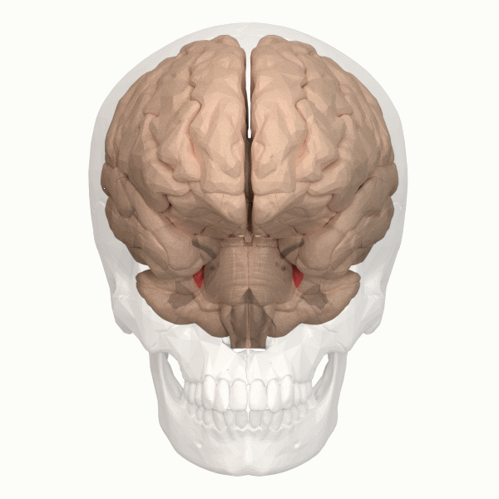
Notes:
Retrieved on 3 January 2021 from: https://commons.wikimedia.org/wiki/Category:Animations_of_human_brain_from_Anatomography#/media/File:Anterior_lobe_of_cerebellum_-_animation.gif

Slide 10
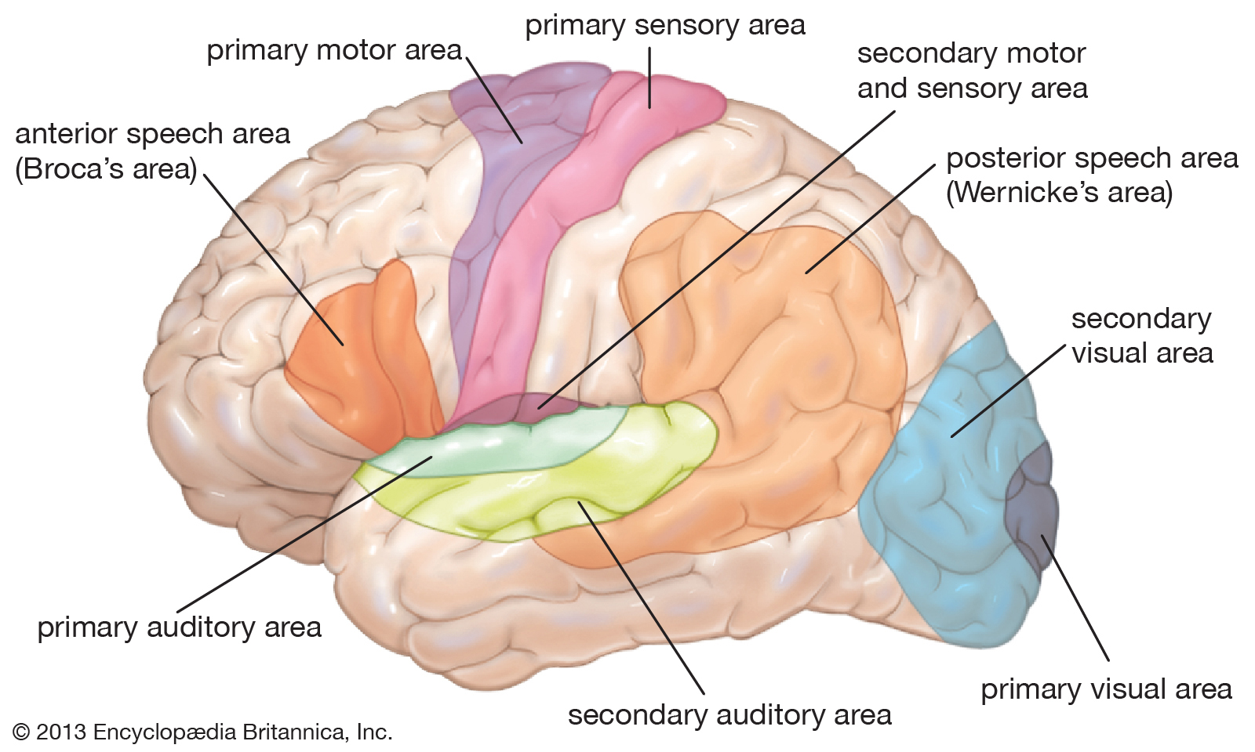
Notes:
Retrieved on 29 February 2020 from: https://www.britannica.com/science/Wernicke-area

Slide 11
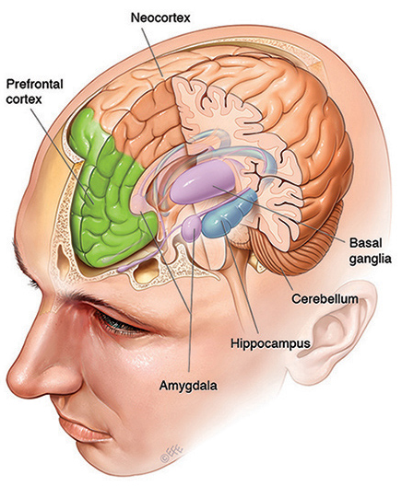
“signals from cortical areas involved in an experience converge on the hippocampus, which serves to interconnect the attributes of the experience”
(Hintzman, 2000, p. 169)
Notes:
Image retrieved on 5 March 2020 from: https://qbi.uq.edu.au/brain-basics/memory/where-are-memories-stored

Slide 12
“a subset of those attributes, reinstated later, allows the hippocampus to reconstruct an approximation of this original experience”
(Hintzman, 2000, p. 169)
Notes:
Image retrieved on 5 March 2020 from: https://qbi.uq.edu.au/brain-basics/memory/where-are-memories-stored

Slide 13
“memory retrieval processes represent the cognitive system's best efforts to reinstate the same pattern of mental activity that occurred during the original experience”
(Brown & Craik, 2000, p. 95)
Notes:
Image retrieved on 5 March 2020 from: https://qbi.uq.edu.au/brain-basics/memory/where-are-memories-stored

Slide 14
“recall amounts not to retrieval but to reconstruction”
(McClelland, 2000, p. 583)
Notes:
Image retrieved on 5 March 2020 from: https://qbi.uq.edu.au/brain-basics/memory/where-are-memories-stored

Slide 15
Memory
Working
Long-term
phonological loop
procedural
visuospatial sketchpad
declarative
semantic
episodic

Slide 16
Memory
Working
Long-term

Slide 17
Memory
Working
Long-term

Slide 18
Memory
Working
Long-term

Slide 19
Memory
Working
Long-term

Slide 20
Memory
Working
Long-term

Slide 21
Memory
Working
Long-term

Slide 22
Memory
Working
Long-term

Slide 23
Memory
Working
Long-term

Slide 24
“successful retrievals facilitate future retrievals”
(Bahrick, 2000, p. 355)
Notes:
Image retrieved on 5 March 2020 from: https://qbi.uq.edu.au/brain-basics/memory/where-are-memories-stored

Slide 25
“The more rehearsal … the individual engages in, the greater the likelihood that the information will
be transferred
from short-term to permanent storage”
(Brown & Craik, 2000, p. 93)
Notes:
Image retrieved on 5 March 2020 from: https://qbi.uq.edu.au/brain-basics/memory/where-are-memories-stored

Slide 26
Memory
Working
Long-term
rehersal

Slide 27
Techniques enhancing memorability
(1) Attention
The key to successful encoding . . . is attention - that is, in order for information to proceed to progressively more capacious and durable stores, the learner has to pay conscious attention to the information.
(Brown & Craik, 2000, p. 93)
Caleb Gattegno: learning begins with awareness that there is something to learn
(Young & Messum, 2011. p. 83)

Slide 28
Techniques enhancing memorability
(1) Attention
focus
occur
There is something to learn!

Slide 29
Techniques enhancing memorability
(1) Attention
(2) Peripheral learning
we can learn from what is present in the environment, even if our attention is not directed to it
(Larsen-Freeman & Anderson, 2011, p. 75;
Lozanov & Gateva, 1988, pp. 21-22)
Peripheral perceptions
(Lozanov, 1978)

Slide 30
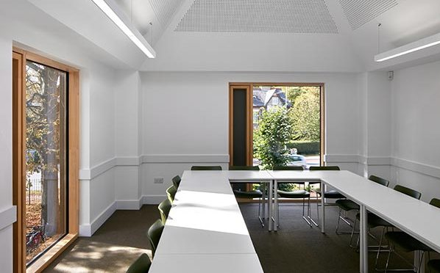
I read
You read
He reads
She reads
It reads

Slide 31
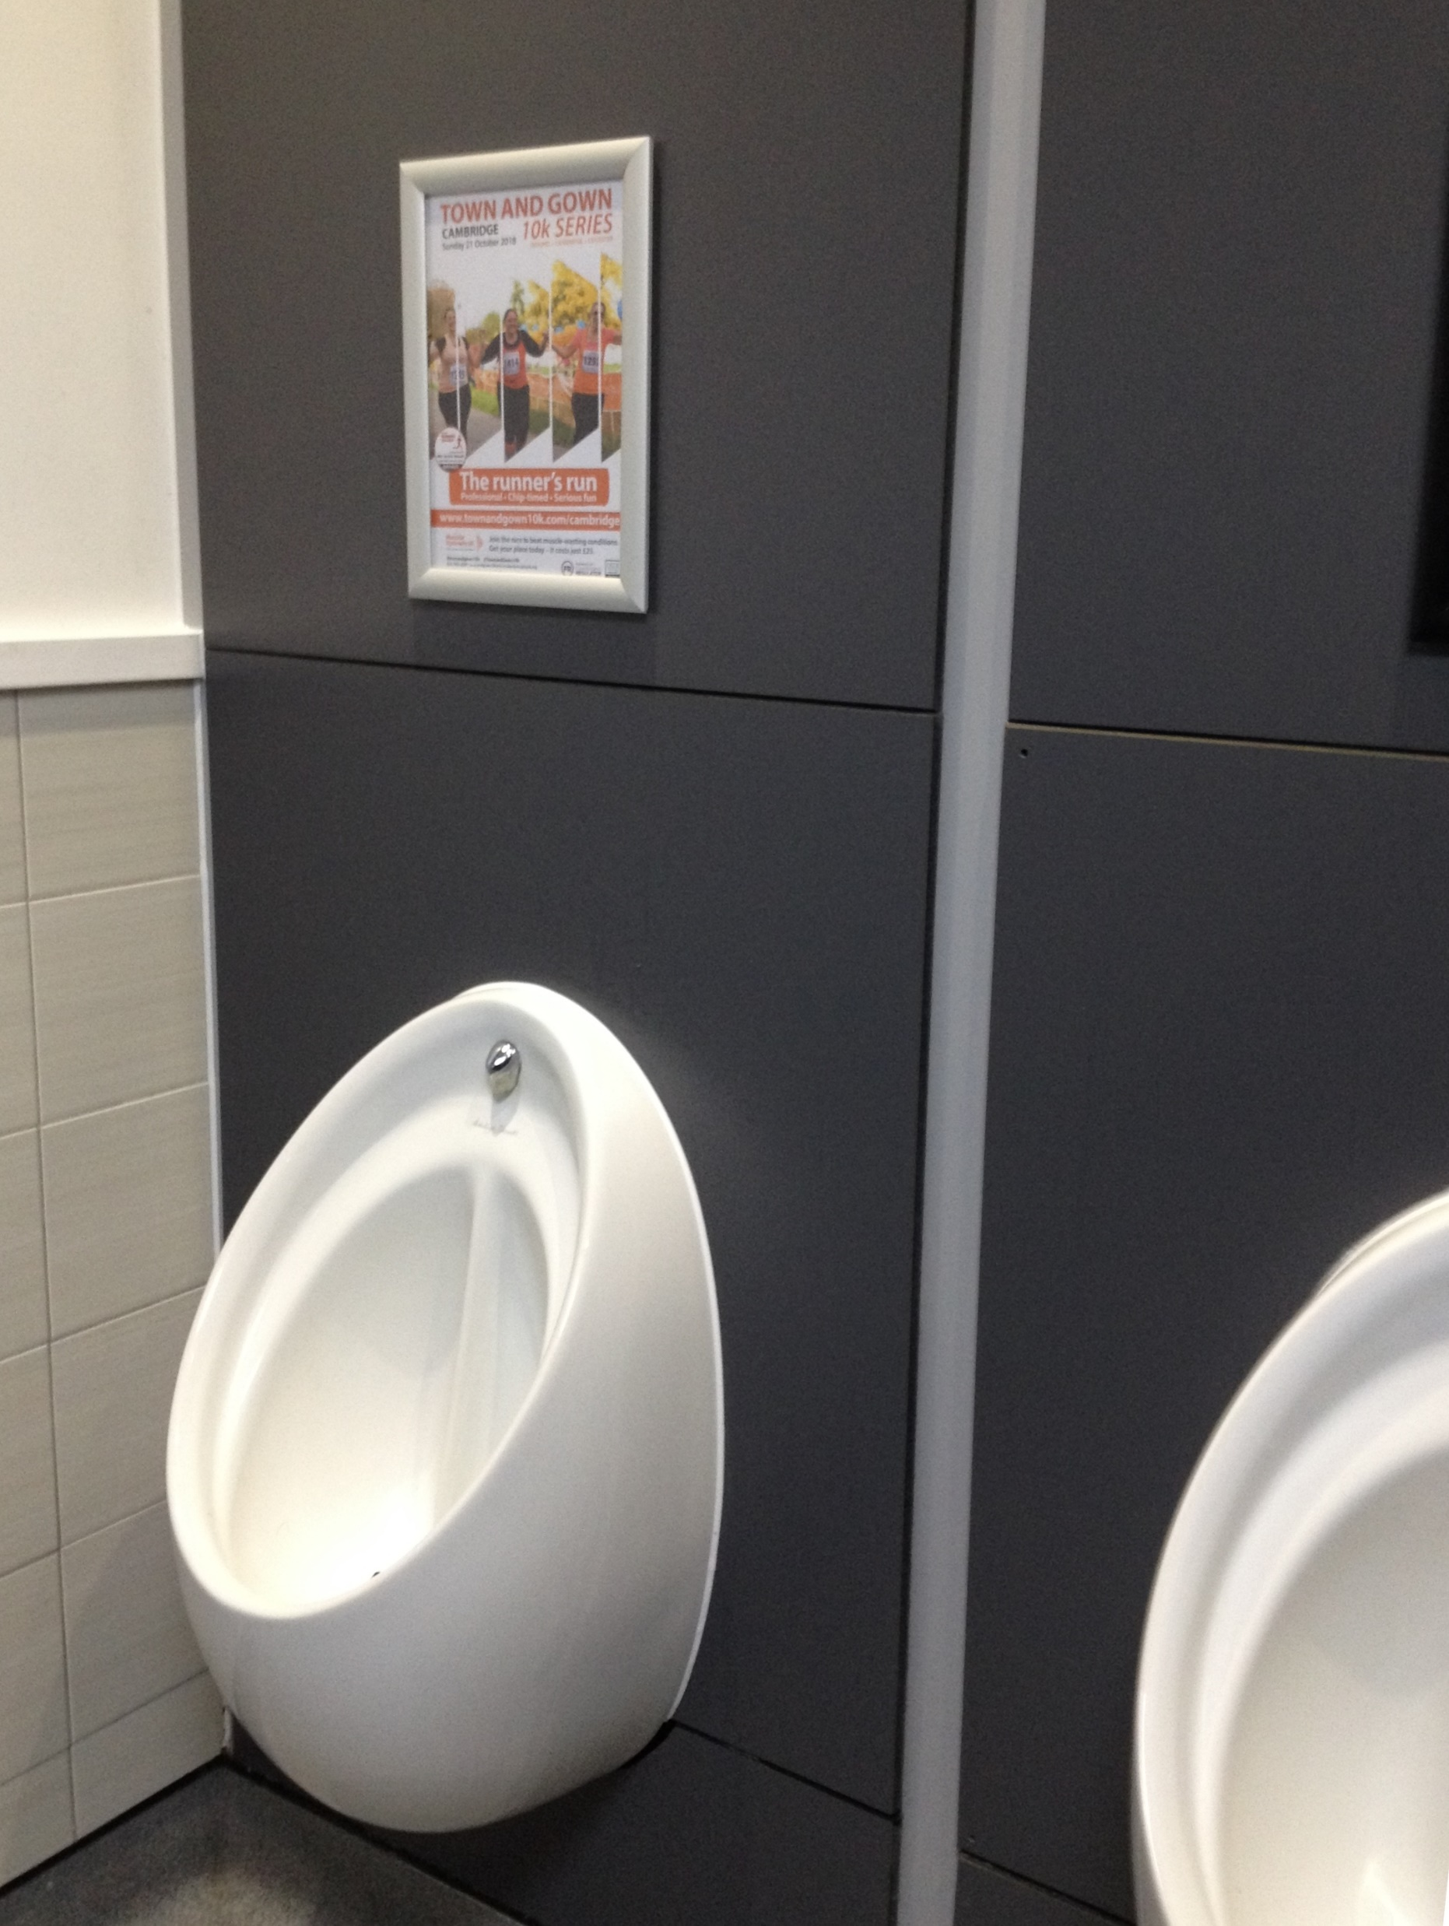

Slide 32
Techniques enhancing memorability
(1) Attention
(2) Peripheral learning
Incidental (nonintentional) learning can be as effective as, or even more effective than, intentional learning
provided that the incidental orienting task induces the learner to process the information in a meaningful, elaborate and distinctive fashion.
(Brown & Craik, 2000, p. 98)

Slide 33
Techniques enhancing memorability
(1) Attention
(2) Peripheral learning
(3) Problem solving
blunt
the "read" condition
sharp ≠ b _ _ n _
the "generate" condition
The generate condition is consistently associated with higher levels of recall.
(Brown & Craik, 2000, p. 102)
guided discovery
(Thornbury, 2017)

Slide 34
Techniques enhancing memorability
(1) Attention
(2) Peripheral learning
(3) Problem solving
(4) Enactment
Memory for enacted action phrases is superior to that for events encoded without enactment.
(Nilsson, 2000, p. 137)

Slide 35
Techniques enhancing memorability
(1) Attention
(2) Peripheral learning
(3) Problem solving
(4) Enactment
(5) Vocalisation
Vocalisation at study, compared with silent reading … increases remember responses.
(Gregg & Gardiner, 1991)

Slide 36
Techniques enhancing memorability
(1) Attention
(2) Peripheral learning
(3) Problem solving
(4) Enactment
(5) Vocalisation
(6) Self-referencing
relating material personally to oneself
(Noice & Noice, 2006, p. 14)

Slide 37
Techniques enhancing memorability
(1) Attention
(2) Peripheral learning
(3) Problem solving
(4) Enactment
(5) Vocalisation
(6) Self-referencing
focus
when there’s complete silence.
I find it hard to
I need complete silence to be able to focus.

Slide 38
Memory
Working
Long-term
phonological loop
procedural
visuospatial sketchpad
declarative
H.M. patient
(Kean, 2014)
semantic
focus
episodic

Slide 39
Techniques enhancing memorability
(1) Attention
(2) Peripheral learning
(3) Problem solving
(4) Enactment
(5) Vocalisation
(6) Self-referencing
focus
when there’s complete silence.
I find it hard to
I need complete silence to be able to focus.

Slide 40

Techniques enhancing memorability
(1) Attention
(2) Peripheral learning
(3) Problem solving
(4) Enactment
(5) Vocalisation
(6) Self-referencing
(7) Image
iridescent
Imagery provides a coding system; items coded in this manner are stored in an "imagery" memory store that is more durable than the verbal memory store.
(Bower, 2000, p. 25)

Slide 41
Techniques enhancing memorability
(1) Attention
(2) Peripheral learning
(3) Problem solving
(4) Enactment
(5) Vocalisation
(6) Self-referencing
(7) Image
(8) Bizarre
ludicrous
Bizarre phrases were better recognised than ordinary phrases.
(Nilsson, 2000, p. 141)

Slide 42
Techniques enhancing memorability
(1) Attention
(2) Peripheral learning
(3) Problem solving
(4) Enactment
(5) Vocalisation
(6) Self-referencing
(7) Image
(8) Bizarre
ludicrous

Slide 43

Techniques enhancing memorability
(1) Attention
(2) Peripheral learning
(3) Problem solving
(4) Enactment
(5) Vocalisation
(6) Self-referencing
(7) Image
(8) Bizarre
(9) Spaced retrieval
Hugh Dellar - Spacing Out: In Praise of Distributed Practice
retention … is best when rehearsals are … spaced out over time, rather than massed together (Brown & Craik, 2000, p. 97)

Slide 44
Techniques enhancing memorability
(1) Attention
(2) Peripheral learning
(3) Problem solving
(4) Enactment
(5) Vocalisation
(6) Self-referencing
(7) Image
(8) Bizarre
(9) Spaced retrieval
(10) Primacy effect
advantage at the beginning of the list
(Crowder & Greene, 2000, p. 129)

Slide 45
focus
when there’s complete silence.
I find it hard to
I need complete silence to be able to focus.

Slide 46
Techniques enhancing memorability
(1) Attention
(2) Peripheral learning
(3) Problem solving
(4) Enactment
(5) Vocalisation
(6) Self-referencing
(7) Image
(8) Bizarre
(9) Spaced retrieval
(10) Primacy effect
Memories may be coded along a multitude of dimensions . . . several codes may be retained from a single experienced event.
(Brown & Craik, 2000, p. 96)

Slide 47
Human memory systems in language education
Sebastian Lesniewski
.com
IATEFL 2021

