Slide 1
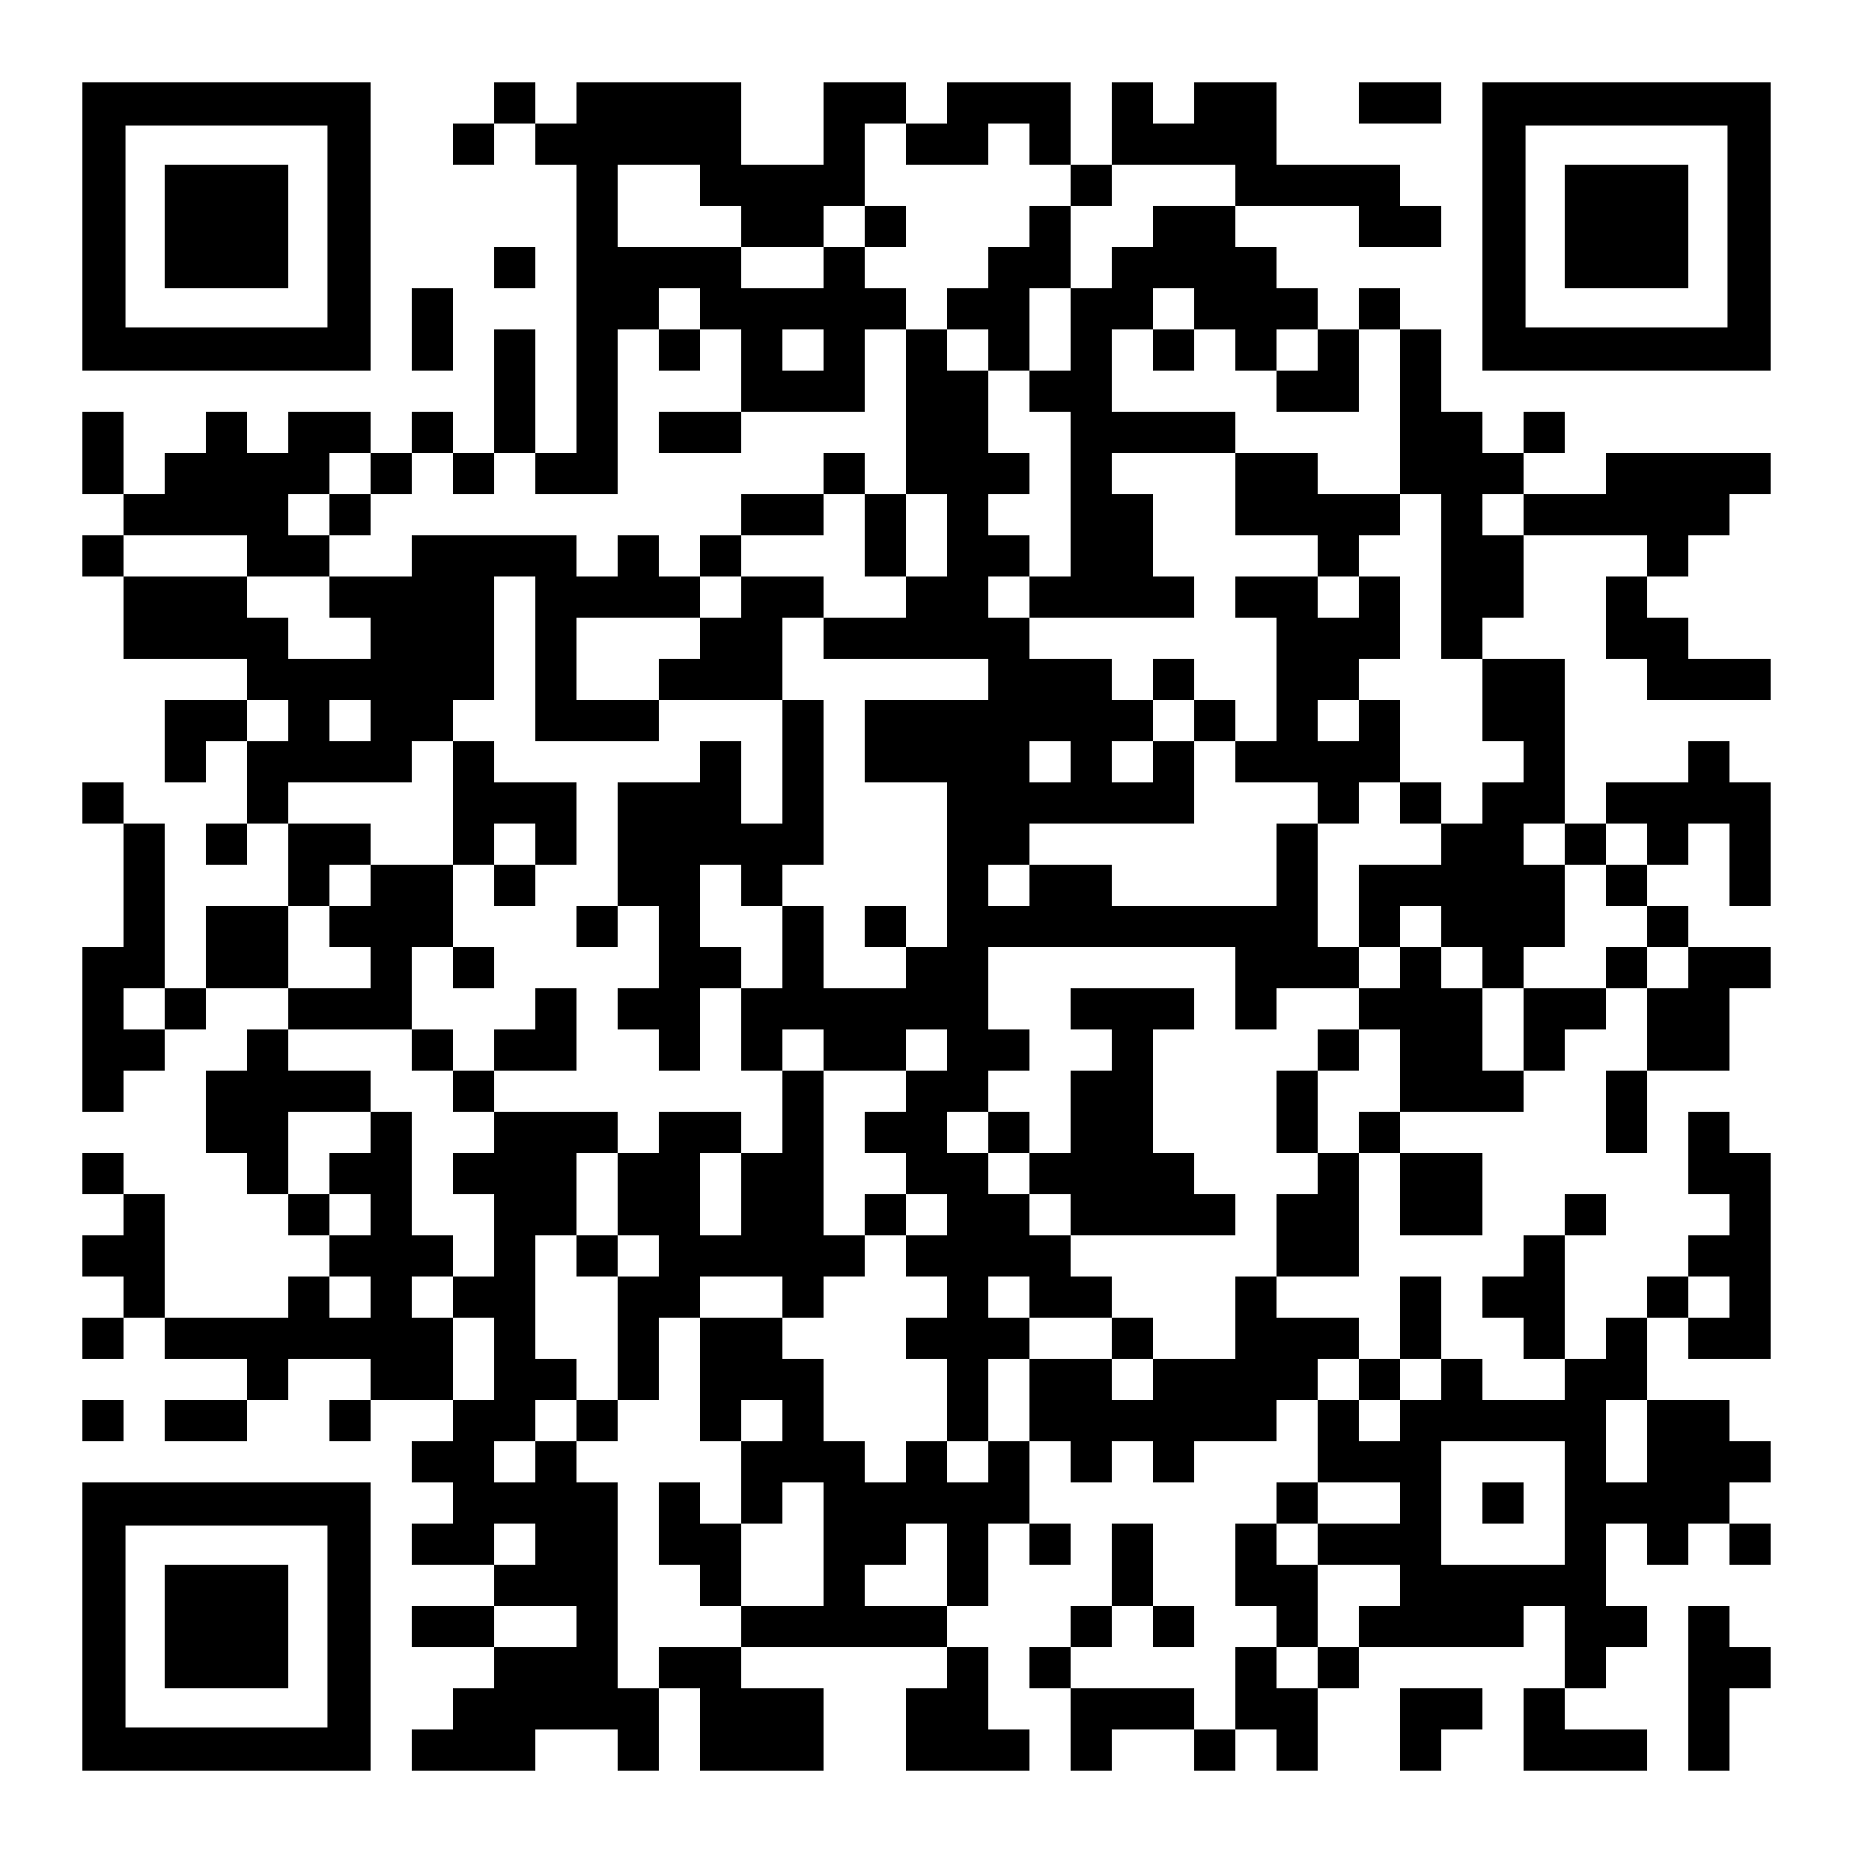
Spot an AI-generated paper when you see one
Download slides
IATEFL Brighton, 24 April 2026
Sebastian.Lesniewski@bil.ac.uk
SebastianLesniewski.com

Slide 2
Where I’m coming from
→ Language/EAP teacher since 2002
→ Pre-sessional courses, Foundation Year programmes
→ Senior Lecturer and Academic Lead for Research since 2021
→ Teaching research methods, supervising UG and PG dissertations
→ Coming to IATEFL conferences since 2012

Slide 3

“AI is the simulation of human intelligence in machines . . . AI involves the development of algorithms and models that enable computers to learn from data and make predictions or decisions based on said data” (Chan & Colloton, 2024, p. 1)
“Generative AI
. . . involves . . . creating new data that resembles the data it was trained on, based on the patterns and relationships learned from existing data” (Chan & Colloton, 2024, pp. 9-10)
– a tool that predicts the next words” (Chan & Colloton, 2024, p. 250)
“LLM

Slide 4
Is this writing AI-generated?
→ Watch out for hallucinations

Slide 5
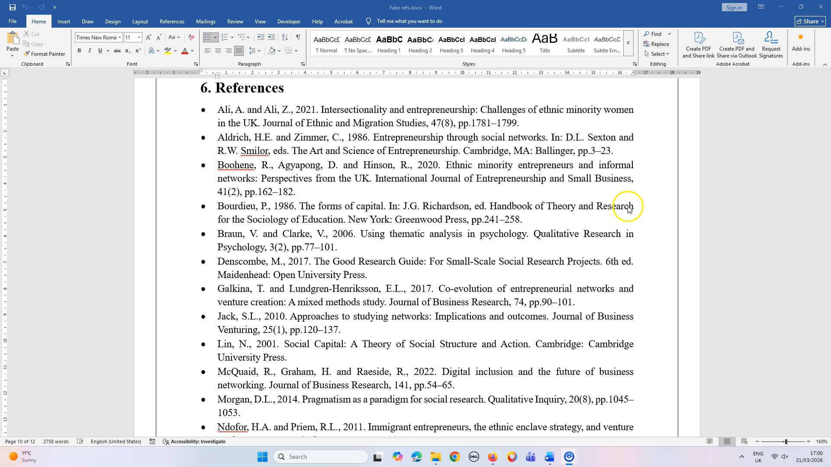

Slide 6
Is this writing AI-generated?
→ Watch out for hallucinations
→ Look at text formatting: bolded phrases, bullet points, headings

Slide 7
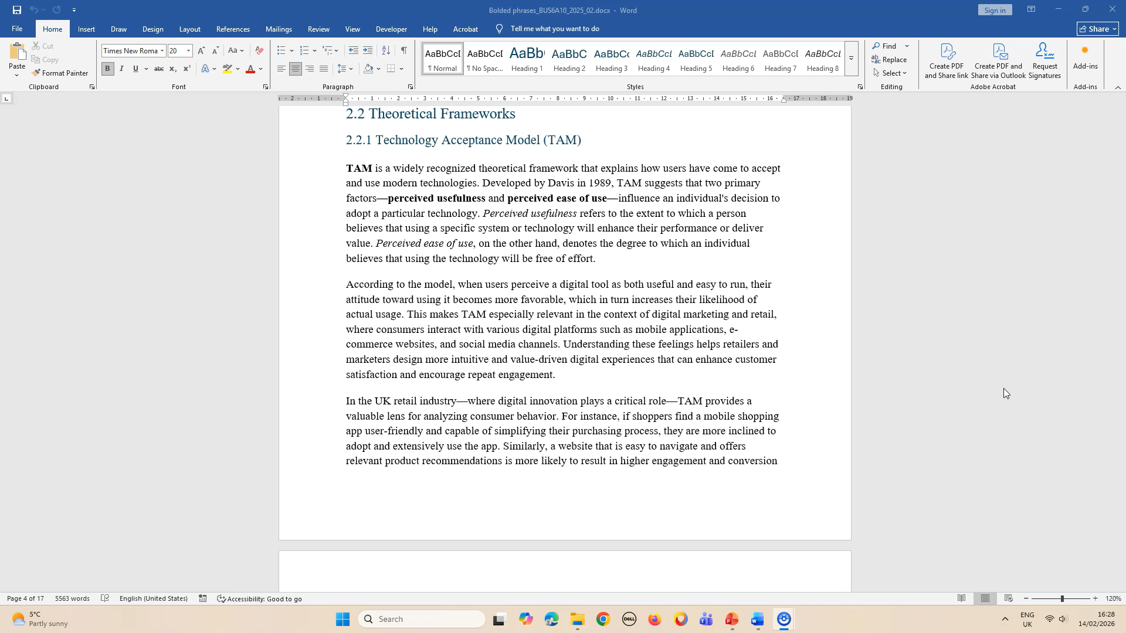

Slide 8
Is this writing AI-generated?
→ Watch out for hallucinations
→ Look at text formatting: bolded phrases, bullet points, headings
→ Look at language

Slide 9
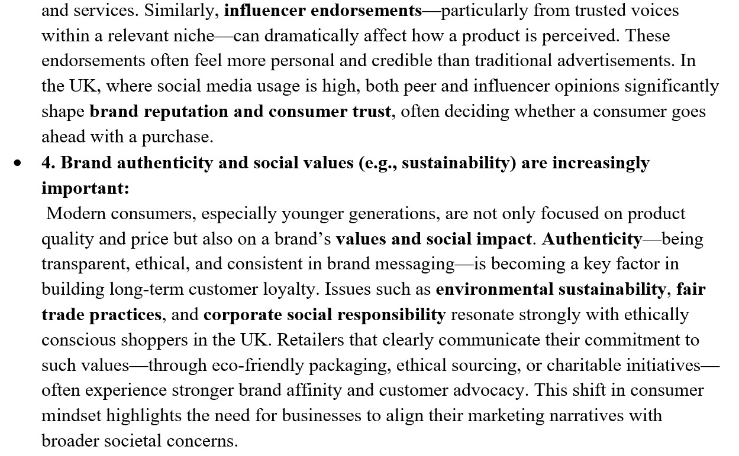

Slide 10
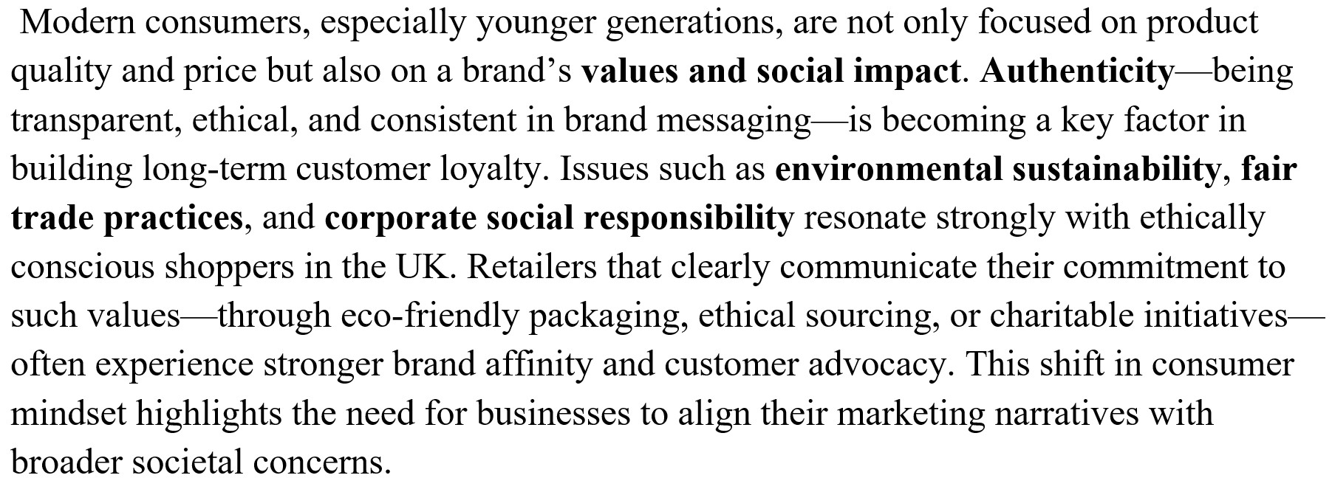

sir i never used any ai in my assignment i don't even know how to use that i made all that by my self i swear sir please recheck my assignment and just give me passing marks

Slide 11
Is this writing AI-generated?
→ Watch out for hallucinations
→ Look at text formatting: bolded phrases, bullet points, headings
→ Look at language
→ Use an AI detector, e.g. gptzero.me

Slide 12
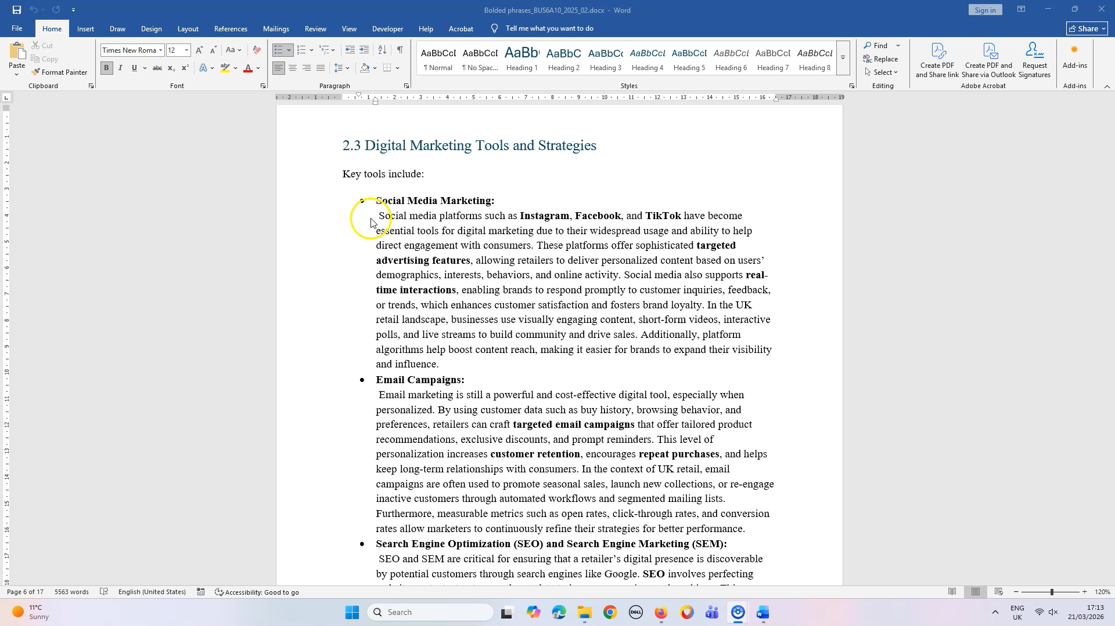

Slide 13
Is this writing AI-generated?
→ Watch out for hallucinations
→ Look at text formatting: bolded phrases, bullet points, headings
→ Look at language
→ Use an AI detector

Slide 14
How Large Language Models work
→ Guess the next word

Slide 15
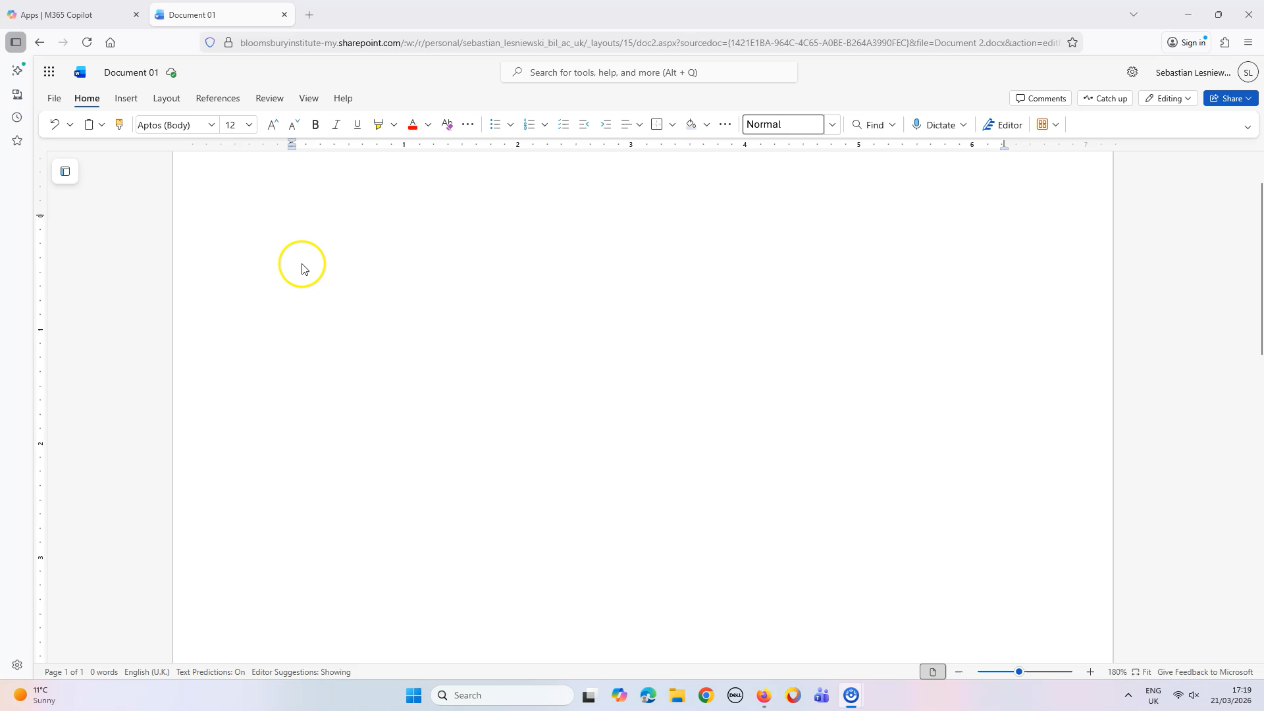

Slide 16
How Large Language Models work
→ Guess the next word
→ Perplexity is a measurement that reflects how well a model can predict the next word based on the preceding context (Mukherjee, 2023; see also Chan & Colloton, 2024, p. 121)
→ Burstiness . . . is a measure of how much writing patterns and text perplexities vary over the entire document (Tian, 2023; see also Chan & Colloton, 2024, p. 121)

Slide 17
Is this writing AI-generated?
→ Watch out for hallucinations
→ Look at text formatting: bolded phrases, bullet points, headings
→ Look at language
→ Use an AI detector
→ AI detectors may give false positives (e.g. Giray, 2024, cf. Gosling et al., 2024)
→ AI detectors can be bypassed (e.g. Gosling et al., 2024)
→ AI detectors are more reliable than humans (e.g. Fleckenstein et al., 2024, Hyatt et al., 2025, cf. Fiedler & Döpke, 2025)
→ AI detectors are most reliable when combined (e.g. Hyatt et al., 2025)

Slide 18
The UK consumers are a sizeable number who claim to be environmentally concerned, but their purchasing behavior is otherwise. Most of the shoppers care more about price, convenience, and recognizable brands as opposed to being sustainable when purchasing food products (Miquel Vidal and Castellano-Tejedor, 2022). Green packaging is becoming a common phenomenon; however, its real effect on purchasing behavior is obscured. Some consumers admire eco-friendly packaging, and those who do not care, provided that the product attached to the packaging is of a higher price or less convenient (Hossain, Nekmahmud, and Fekete-Farkas, 2022). Moreover, Retailers are faced with the increasing pressure to invest in sustainable packaging, investing in recyclable material, reduced-plastic design, and eco-friendly labelling. However, they are not sure whether they can result in more sales or customer loyalty. Lack of clear evidence can make companies unable to devise viable sustainability strategies (Roy, 2022). Furthermore, consumers have a different interpretation of green packaging. Some take it seriously, and others are still doubtful of environmental assertions (Petkowicz et al., 2024). This ambivalence makes it difficult to predict the shopper's behavior. As a result, research on the real consumer behavior of the eco-friendly packaging in the UK food sector is needed to shed light on the motivations, obstacles, and decision-making factors (Boz, Korhonen, and Sand, 2020).

Slide 19
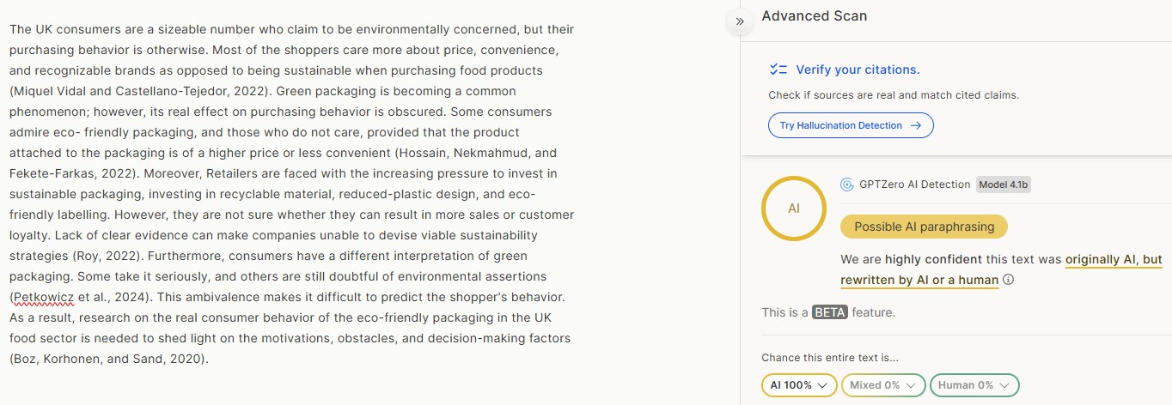
→ gptzero.me

Slide 20
The UK consumers are a sizeable number who claim to be environmentally concerned, but their purchasing behavior is otherwise. Most of the shoppers care more about price, convenience, and recognizable brands as opposed to being sustainable when purchasing food products (Miquel Vidal and Castellano-Tejedor, 2022). Green packaging is becoming a common phenomenon; however, its real effect on purchasing behavior is obscured. Some consumers admire eco-friendly packaging, and those who do not care, provided that the product attached to the packaging is of a higher price or less convenient (Hossain, Nekmahmud, and Fekete-Farkas, 2022). Moreover, Retailers are faced with the increasing pressure to invest in sustainable packaging, investing in recyclable material, reduced-plastic design, and eco-friendly labelling. However, they are not sure whether they can result in more sales or customer loyalty. Lack of clear evidence can make companies unable to devise viable sustainability strategies (Roy, 2022). Furthermore, consumers have a different interpretation of green packaging. Some take it seriously, and others are still doubtful of environmental assertions (Petkowicz et al., 2024). This ambivalence makes it difficult to predict the shopper's behavior. As a result, research on the real consumer behavior of the eco-friendly packaging in the UK food sector is needed to shed light on the motivations, obstacles, and decision-making factors (Boz, Korhonen, and Sand, 2020).

Slide 21
→ Humanise = mess up the grammar/wording a bit

Slide 22
The UK consumers are a sizeable number who claim to be environmentally concerned, but their purchasing behavior is otherwise. Most of the shoppers care more about price, convenience, and recognizable brands as opposed to being sustainable when purchasing food products (Miquel Vidal and Castellano-Tejedor, 2022). Green packaging is becoming a common phenomenon; however, its real effect on purchasing behavior is obscured. Some consumers admire eco-friendly packaging, and those who do not care, provided that the product attached to the packaging is of a higher price or less convenient (Hossain, Nekmahmud, and Fekete-Farkas, 2022). Moreover, Retailers are faced with the increasing pressure to invest in sustainable packaging, investing in recyclable material, reduced-plastic design, and eco-friendly labelling. However, they are not sure whether they can result in more sales or customer loyalty. Lack of clear evidence can make companies unable to devise viable sustainability strategies (Roy, 2022). Furthermore, consumers have a different interpretation of green packaging. Some take it seriously, and others are still doubtful of environmental assertions (Petkowicz et al., 2024). This ambivalence makes it difficult to predict the shopper's behavior. As a result, research on the real consumer behavior of the eco-friendly packaging in the UK food sector is needed to shed light on the motivations, obstacles, and decision-making factors (Boz, Korhonen, and Sand, 2020).

Slide 23
The UK consumers are a sizeable number who claim to be environmentally concerned, but their purchasing behavior is otherwise. Most of the shoppers care more about price, convenience, and recognizable brands as opposed to being sustainable when purchasing food products (Miquel Vidal and Castellano-Tejedor, 2022). Green packaging is becoming a common phenomenon; however, its real effect on purchasing behavior is obscured. Some consumers admire eco-friendly packaging, and those who do not care, provided that the product attached to the packaging is of a higher price or less convenient (Hossain, Nekmahmud, and Fekete-Farkas, 2022). Moreover, Retailers are faced with the increasing pressure to invest in sustainable packaging, investing in recyclable material, reduced-plastic design, and eco-friendly labelling. However, they are not sure whether they can result in more sales or customer loyalty. Lack of clear evidence can make companies unable to devise viable sustainability strategies (Roy, 2022). Furthermore, consumers have a different interpretation of green packaging. Some take it seriously, and others are still doubtful of environmental assertions (Petkowicz et al., 2024). This ambivalence makes it difficult to predict the shopper's behavior. As a result, research on the real consumer behavior of the eco-friendly packaging in the UK food sector is needed to shed light on the motivations, obstacles, and decision-making factors (Boz, Korhonen, and Sand, 2020).
(215 words)

Slide 24
→ Humanise = mess up the grammar/wording a bit
→ Dazzle the reader with citations (215 words, 5 citations)

Slide 25
The UK consumers are a sizeable number who claim to be environmentally concerned, but their purchasing behavior is otherwise. Most of the shoppers care more about price, convenience, and recognizable brands as opposed to being sustainable when purchasing food products (Miquel Vidal and Castellano-Tejedor, 2022). Green packaging is becoming a common phenomenon; however, its real effect on purchasing behavior is obscured. Some consumers admire eco-friendly packaging, and those who do not care, provided that the product attached to the packaging is of a higher price or less convenient (Hossain, Nekmahmud, and Fekete-Farkas, 2022). Moreover, Retailers are faced with the increasing pressure to invest in sustainable packaging, investing in recyclable material, reduced-plastic design, and eco-friendly labelling. However, they are not sure whether they can result in more sales or customer loyalty. Lack of clear evidence can make companies unable to devise viable sustainability strategies (Roy, 2022). Furthermore, consumers have a different interpretation of green packaging. Some take it seriously, and others are still doubtful of environmental assertions (Petkowicz et al., 2024). This ambivalence makes it difficult to predict the shopper's behavior. As a result, research on the real consumer behavior of the eco-friendly packaging in the UK food sector is needed to shed light on the motivations, obstacles, and decision-making factors (Boz, Korhonen, and Sand, 2020).

Slide 26
The UK consumers are a sizeable number who claim to be environmentally concerned, but their purchasing behavior is otherwise. Most of the shoppers care more about price, convenience, and recognizable brands as opposed to being sustainable when purchasing food products (Miquel Vidal and Castellano-Tejedor, 2022). Green packaging is becoming a common phenomenon; however, its real effect on purchasing behavior is obscured. Some consumers admire eco-friendly packaging, and those who do not care, provided that the product attached to the packaging is of a higher price or less convenient (Hossain, Nekmahmud, and Fekete-Farkas, 2022). Moreover, Retailers are faced with the increasing pressure to invest in sustainable packaging, investing in recyclable material, reduced-plastic design, and eco-friendly labelling. However, they are not sure whether they can result in more sales or customer loyalty. Lack of clear evidence can make companies unable to devise viable sustainability strategies (Roy, 2022). Furthermore, consumers have a different interpretation of green packaging. Some take it seriously, and others are still doubtful of environmental assertions (Petkowicz et al., 2024). This ambivalence makes it difficult to predict the shopper's behavior. As a result, research on the real consumer behavior of the eco-friendly packaging in the UK food sector is needed to shed light on the motivations, obstacles, and decision-making factors (Boz, Korhonen, and Sand, 2020).

Slide 27
The UK consumers are a sizeable number who claim to be environmentally concerned, but their purchasing behavior is otherwise. Most of the shoppers care more about price, convenience, and recognizable brands as opposed to being sustainable when purchasing food products (Miquel Vidal and Castellano-Tejedor, 2022). Green packaging is becoming a common phenomenon; however, its real effect on purchasing behavior is obscured. Some consumers admire eco-friendly packaging, and those who do not care, provided that the product attached to the packaging is of a higher price or less convenient (Hossain, Nekmahmud, and Fekete-Farkas, 2022). Moreover, Retailers are faced with the increasing pressure to invest in sustainable packaging, investing in recyclable material, reduced-plastic design, and eco-friendly labelling. However, they are not sure whether they can result in more sales or customer loyalty. Lack of clear evidence can make companies unable to devise viable sustainability strategies (Roy, 2022). Furthermore, consumers have a different interpretation of green packaging. Some take it seriously, and others are still doubtful of environmental assertions (Petkowicz et al., 2024). This ambivalence makes it difficult to predict the shopper's behavior. As a result, research on the real consumer behavior of the eco-friendly packaging in the UK food sector is needed to shed light on the motivations, obstacles, and decision-making factors (Boz, Korhonen, and Sand, 2020).

Slide 28
Miquel Vidal, M., & Castellano-Tejedor, C. (2022). Identification of marketing strategies influencing consumers’ perception of healthy food products and triggering purchasing decisions. Businesses, 2(4), 410-422. https://doi.org/10.3390/businesses2040026
“Using green packaging, nutritional claims related to low-calorie intakes or accentuating salt and macronutrient content, and using opinion leaders with whom consumers can relate to, were the most influential factors in fostering a healthy perception of pre-packaged food products.”

Slide 29
Miquel Vidal, M., & Castellano-Tejedor, C. (2022). Identification of marketing strategies influencing consumers’ perception of healthy food products and triggering purchasing decisions. Businesses, 2(4), 410-422. https://doi.org/10.3390/businesses2040026
“Using green packaging, nutritional claims related to low-calorie intakes or accentuating salt and macronutrient content, and using opinion leaders with whom consumers can relate to, were the most influential factors in fostering a healthy perception of pre-packaged food products.”

Slide 30
The UK consumers are a sizeable number who claim to be environmentally concerned, but their purchasing behavior is otherwise. Most of the shoppers care more about price, convenience, and recognizable brands as opposed to being sustainable when purchasing food products (Miquel Vidal and Castellano-Tejedor, 2022). Green packaging is becoming a common phenomenon; however, its real effect on purchasing behavior is obscured. Some consumers admire eco-friendly packaging, and those who do not care, provided that the product attached to the packaging is of a higher price or less convenient (Hossain, Nekmahmud, and Fekete-Farkas, 2022). Moreover, Retailers are faced with the increasing pressure to invest in sustainable packaging, investing in recyclable material, reduced-plastic design, and eco-friendly labelling. However, they are not sure whether they can result in more sales or customer loyalty. Lack of clear evidence can make companies unable to devise viable sustainability strategies (Roy, 2022). Furthermore, consumers have a different interpretation of green packaging. Some take it seriously, and others are still doubtful of environmental assertions (Petkowicz et al., 2024). This ambivalence makes it difficult to predict the shopper's behavior. As a result, research on the real consumer behavior of the eco-friendly packaging in the UK food sector is needed to shed light on the motivations, obstacles, and decision-making factors (Boz, Korhonen, and Sand, 2020).

Slide 31
→ Humanise = mess up the grammar/wording a bit
→ Dazzle the reader with citations (215 words, 5 citations)
→ Misuse citations (misrepresent the original source's meaning, cite irrelevant works to pad references)

Slide 32
The UK consumers are a sizeable number who claim to be environmentally concerned, but their purchasing behavior is otherwise. Most of the shoppers care more about price, convenience, and recognizable brands as opposed to being sustainable when purchasing food products (Miquel Vidal and Castellano-Tejedor, 2022). Green packaging is becoming a common phenomenon; however, its real effect on purchasing behavior is obscured. Some consumers admire eco-friendly packaging, and those who do not care, provided that the product attached to the packaging is of a higher price or less convenient (Hossain, Nekmahmud, and Fekete-Farkas, 2022). Moreover, Retailers are faced with the increasing pressure to invest in sustainable packaging, investing in recyclable material, reduced-plastic design, and eco-friendly labelling. However, they are not sure whether they can result in more sales or customer loyalty. Lack of clear evidence can make companies unable to devise viable sustainability strategies (Roy, 2022). Furthermore, consumers have a different interpretation of green packaging. Some take it seriously, and others are still doubtful of environmental assertions (Petkowicz et al., 2024). This ambivalence makes it difficult to predict the shopper's behavior. As a result, research on the real consumer behavior of the eco-friendly packaging in the UK food sector is needed to shed light on the motivations, obstacles, and decision-making factors (Boz, Korhonen, and Sand, 2020).

Slide 33
The UK consumers are a sizeable number who claim to be environmentally concerned, but their purchasing behavior is otherwise. Most of the shoppers care more about price, convenience, and recognizable brands as opposed to being sustainable when purchasing food products (Miquel Vidal and Castellano-Tejedor, 2022). Green packaging is becoming a common phenomenon; however, its real effect on purchasing behavior is obscured. Some consumers admire eco-friendly packaging, and those who do not care, provided that the product attached to the packaging is of a higher price or less convenient (Hossain, Nekmahmud, and Fekete-Farkas, 2022). Moreover, Retailers are faced with the increasing pressure to invest in sustainable packaging, investing in recyclable material, reduced-plastic design, and eco-friendly labelling. However, they are not sure whether they can result in more sales or customer loyalty. Lack of clear evidence can make companies unable to devise viable sustainability strategies (Roy, 2022). Furthermore, consumers have a different interpretation of green packaging. Some take it seriously, and others are still doubtful of environmental assertions (Petkowicz et al., 2024). This ambivalence makes it difficult to predict the shopper's behavior. As a result, research on the real consumer behavior of the eco-friendly packaging in the UK food sector is needed to shed light on the motivations, obstacles, and decision-making factors (Boz, Korhonen, and Sand, 2020).

Slide 34
The UK consumers are a sizeable number who claim to be environmentally concerned, but their purchasing behavior is otherwise. Most of the shoppers care more about price, convenience, and recognizable brands as opposed to being sustainable when purchasing food products (Miquel Vidal and Castellano-Tejedor, 2022). Green packaging is becoming a common phenomenon; however, its real effect on purchasing behavior is obscured. Some consumers admire eco-friendly packaging, and those who do not care, provided that the product attached to the packaging is of a higher price or less convenient (Hossain, Nekmahmud, and Fekete-Farkas, 2022). Moreover, Retailers are faced with the increasing pressure to invest in sustainable packaging, investing in recyclable material, reduced-plastic design, and eco-friendly labelling. However, they are not sure whether they can result in more sales or customer loyalty. Lack of clear evidence can make companies unable to devise viable sustainability strategies (Roy, 2022). Furthermore, consumers have a different interpretation of green packaging. Some take it seriously, and others are still doubtful of environmental assertions (Petkowicz et al., 2024). This ambivalence makes it difficult to predict the shopper's behavior. As a result, research on the real consumer behavior of the eco-friendly packaging in the UK food sector is needed to shed light on the motivations, obstacles, and decision-making factors (Boz, Korhonen, and Sand, 2020).

Slide 35
The UK consumers are a sizeable number who claim to be environmentally concerned, but their purchasing behavior is otherwise. Most of the shoppers care more about price, convenience, and recognizable brands as opposed to being sustainable when purchasing food products (Miquel Vidal and Castellano-Tejedor, 2022). Green packaging is becoming a common phenomenon; however, its real effect on purchasing behavior is obscured. Some consumers admire eco-friendly packaging, and those who do not care, provided that the product attached to the packaging is of a higher price or less convenient (Hossain, Nekmahmud, and Fekete-Farkas, 2022). Moreover, Retailers are faced with the increasing pressure to invest in sustainable packaging, investing in recyclable material, reduced-plastic design, and eco-friendly labelling. However, they are not sure whether they can result in more sales or customer loyalty. Lack of clear evidence can make companies unable to devise viable sustainability strategies (Roy, 2022). Furthermore, consumers have a different interpretation of green packaging. Some take it seriously, and others are still doubtful of environmental assertions (Petkowicz et al., 2024). This ambivalence makes it difficult to predict the shopper's behavior. As a result, research on the real consumer behavior of the eco-friendly packaging in the UK food sector is needed to shed light on the motivations, obstacles, and decision-making factors (Boz, Korhonen, and Sand, 2020).

Slide 36
The UK consumers are a sizeable number who claim to be environmentally concerned, but their purchasing behavior is otherwise. Most of the shoppers care more about price, convenience, and recognizable brands as opposed to being sustainable when purchasing food products (Miquel Vidal and Castellano-Tejedor, 2022). Green packaging is becoming a common phenomenon; however, its real effect on purchasing behavior is obscured. Some consumers admire eco-friendly packaging, and those who do not care, provided that the product attached to the packaging is of a higher price or less convenient (Hossain, Nekmahmud, and Fekete-Farkas, 2022). Moreover, Retailers are faced with the increasing pressure to invest in sustainable packaging, investing in recyclable material, reduced-plastic design, and eco-friendly labelling. However, they are not sure whether they can result in more sales or customer loyalty. Lack of clear evidence can make companies unable to devise viable sustainability strategies (Roy, 2022). Furthermore, consumers have a different interpretation of green packaging. Some take it seriously, and others are still doubtful of environmental assertions (Petkowicz et al., 2024). This ambivalence makes it difficult to predict the shopper's behavior. As a result, research on the real consumer behavior of the eco-friendly packaging in the UK food sector is needed to shed light on the motivations, obstacles, and decision-making factors (Boz, Korhonen, and Sand, 2020).

Slide 37
Silly / uncritical / naive use of AI
→ Humanise = mess up the grammar/wording a bit
→ Dazzle the reader with citations (215 words, 5 citations)
→ Misuse citations (misrepresent the original source's meaning, cite irrelevant works to pad references)
→ Vagueness
Notes:
It’s true that everything is complex; but that’s not a terribly spectacular discovery; it would be useful to say specifically what makes the situation complex

Slide 38
The UK consumers are a sizeable number who claim to be environmentally concerned, but their purchasing behavior is otherwise. Most of the shoppers care more about price, convenience, and recognizable brands as opposed to being sustainable when purchasing food products (Miquel Vidal and Castellano-Tejedor, 2022). Green packaging is becoming a common phenomenon; however, its real effect on purchasing behavior is obscured. Some consumers admire eco-friendly packaging, and those who do not care, provided that the product attached to the packaging is of a higher price or less convenient (Hossain, Nekmahmud, and Fekete-Farkas, 2022). Moreover, Retailers are faced with the increasing pressure to invest in sustainable packaging, investing in recyclable material, reduced-plastic design, and eco-friendly labelling. However, they are not sure whether they can result in more sales or customer loyalty. Lack of clear evidence can make companies unable to devise viable sustainability strategies (Roy, 2022). Furthermore, consumers have a different interpretation of green packaging. Some take it seriously, and others are still doubtful of environmental assertions (Petkowicz et al., 2024). This ambivalence makes it difficult to predict the shopper's behavior. As a result, research on the real consumer behavior of the eco-friendly packaging in the UK food sector is needed to shed light on the motivations, obstacles, and decision-making factors (Boz, Korhonen, and Sand, 2020).

Slide 39
The UK consumers are a sizeable number who claim to be environmentally concerned, but their purchasing behavior is otherwise. Most of the shoppers care more about price, convenience, and recognizable brands as opposed to being sustainable when purchasing food products (Miquel Vidal and Castellano-Tejedor, 2022). Green packaging is becoming a common phenomenon; however, its real effect on purchasing behavior is obscured. Some consumers admire eco-friendly packaging, and those who do not care, provided that the product attached to the packaging is of a higher price or less convenient (Hossain, Nekmahmud, and Fekete-Farkas, 2022). Moreover, Retailers are faced with the increasing pressure to invest in sustainable packaging, investing in recyclable material, reduced-plastic design, and eco-friendly labelling. However, they are not sure whether they can result in more sales or customer loyalty. Lack of clear evidence can make companies unable to devise viable sustainability strategies (Roy, 2022). Furthermore, consumers have a different interpretation of green packaging. Some take it seriously, and others are still doubtful of environmental assertions (Petkowicz et al., 2024). This ambivalence makes it difficult to predict the shopper's behavior. As a result, research on the real consumer behavior of the eco-friendly packaging in the UK food sector is needed to shed light on the motivations, obstacles, and decision-making factors (Boz, Korhonen, and Sand, 2020).

Slide 40
The UK consumers are a sizeable number who claim to be environmentally concerned, but their purchasing behavior is otherwise. Most of the shoppers care more about price, convenience, and recognizable brands as opposed to being sustainable when purchasing food products (Miquel Vidal and Castellano-Tejedor, 2022). Green packaging is becoming a common phenomenon; however, its real effect on purchasing behavior is obscured. Some consumers admire eco-friendly packaging, and those who do not care, provided that the product attached to the packaging is of a higher price or less convenient (Hossain, Nekmahmud, and Fekete-Farkas, 2022). Moreover, Retailers are faced with the increasing pressure to invest in sustainable packaging, investing in recyclable material, reduced-plastic design, and eco-friendly labelling. However, they are not sure whether they can result in more sales or customer loyalty. Lack of clear evidence can make companies unable to devise viable sustainability strategies (Roy, 2022). Furthermore, consumers have a different interpretation of green packaging. Some take it seriously, and others are still doubtful of environmental assertions (Petkowicz et al., 2024). This ambivalence makes it difficult to predict the shopper's behavior. As a result, research on the real consumer behavior of the eco-friendly packaging in the UK food sector is needed to shed light on the motivations, obstacles, and decision-making factors (Boz, Korhonen, and Sand, 2020).

Slide 41
The UK consumers are a sizeable number who claim to be environmentally concerned, but their purchasing behavior is otherwise. Most of the shoppers care more about price, convenience, and recognizable brands as opposed to being sustainable when purchasing food products (Miquel Vidal and Castellano-Tejedor, 2022). Green packaging is becoming a common phenomenon; however, its real effect on purchasing behavior is obscured. Some consumers admire eco-friendly packaging, and those who do not care, provided that the product attached to the packaging is of a higher price or less convenient (Hossain, Nekmahmud, and Fekete-Farkas, 2022). Moreover, Retailers are faced with the increasing pressure to invest in sustainable packaging, investing in recyclable material, reduced-plastic design, and eco-friendly labelling. However, they are not sure whether they can result in more sales or customer loyalty. Lack of clear evidence can make companies unable to devise viable sustainability strategies (Roy, 2022). Furthermore, consumers have a different interpretation of green packaging. Some take it seriously, and others are still doubtful of environmental assertions (Petkowicz et al., 2024). This ambivalence makes it difficult to predict the shopper's behavior. As a result, research on the real consumer behavior of the eco-friendly packaging in the UK food sector is needed to shed light on the motivations, obstacles, and decision-making factors (Boz, Korhonen, and Sand, 2020).

Slide 42
The UK consumers are a sizeable number who claim to be environmentally concerned, but their purchasing behavior is otherwise. Most of the shoppers care more about price, convenience, and recognizable brands as opposed to being sustainable when purchasing food products (Miquel Vidal and Castellano-Tejedor, 2022). Green packaging is becoming a common phenomenon; however, its real effect on purchasing behavior is obscured. Some consumers admire eco-friendly packaging, and those who do not care, provided that the product attached to the packaging is of a higher price or less convenient (Hossain, Nekmahmud, and Fekete-Farkas, 2022). Moreover, Retailers are faced with the increasing pressure to invest in sustainable packaging, investing in recyclable material, reduced-plastic design, and eco-friendly labelling. However, they are not sure whether they can result in more sales or customer loyalty. Lack of clear evidence can make companies unable to devise viable sustainability strategies (Roy, 2022). Furthermore, consumers have a different interpretation of green packaging. Some take it seriously, and others are still doubtful of environmental assertions (Petkowicz et al., 2024). This ambivalence makes it difficult to predict the shopper's behavior. As a result, research on the real consumer behavior of the eco-friendly packaging in the UK food sector is needed to shed light on the motivations, obstacles, and decision-making factors (Boz, Korhonen, and Sand, 2020).

Slide 43
The UK consumers are a sizeable number who claim to be environmentally concerned, but their purchasing behavior is otherwise. Most of the shoppers care more about price, convenience, and recognizable brands as opposed to being sustainable when purchasing food products (Miquel Vidal and Castellano-Tejedor, 2022). Green packaging is becoming a common phenomenon; however, its real effect on purchasing behavior is obscured. Some consumers admire eco-friendly packaging, and those who do not care, provided that the product attached to the packaging is of a higher price or less convenient (Hossain, Nekmahmud, and Fekete-Farkas, 2022). Moreover, Retailers are faced with the increasing pressure to invest in sustainable packaging, investing in recyclable material, reduced-plastic design, and eco-friendly labelling. However, they are not sure whether they can result in more sales or customer loyalty. Lack of clear evidence can make companies unable to devise viable sustainability strategies (Roy, 2022). Furthermore, consumers have a different interpretation of green packaging. Some take it seriously, and others are still doubtful of environmental assertions (Petkowicz et al., 2024). This ambivalence makes it difficult to predict the shopper's behavior. As a result, research on the real consumer behavior of the eco-friendly packaging in the UK food sector is needed to shed light on the motivations, obstacles, and decision-making factors (Boz, Korhonen, and Sand, 2020).

Slide 44
Silly / uncritical / naive use of AI
→ Humanise = mess up the grammar/wording a bit
→ Dazzle the reader with citations (215 words, 5 citations)
→ Misuse citations (misrepresent the original source's meaning, cite irrelevant works to pad references)
→ Vagueness
, lack of detail, everything is complex, nothing is certain
Notes:
It’s true that everything is complex; but that’s not a terribly spectacular discovery; it would be useful to say specifically what makes the situation complex

Slide 45
The UK consumers are a sizeable number who claim to be environmentally concerned, but their purchasing behavior is otherwise. Most of the shoppers care more about price, convenience, and recognizable brands as opposed to being sustainable when purchasing food products (Miquel Vidal and Castellano-Tejedor, 2022). Green packaging is becoming a common phenomenon; however, its real effect on purchasing behavior is obscured. Some consumers admire eco-friendly packaging, and those who do not care, provided that the product attached to the packaging is of a higher price or less convenient (Hossain, Nekmahmud, and Fekete-Farkas, 2022). Moreover, Retailers are faced with the increasing pressure to invest in sustainable packaging, investing in recyclable material, reduced-plastic design, and eco-friendly labelling. However, they are not sure whether they can result in more sales or customer loyalty. Lack of clear evidence can make companies unable to devise viable sustainability strategies (Roy, 2022). Furthermore, consumers have a different interpretation of green packaging. Some take it seriously, and others are still doubtful of environmental assertions (Petkowicz et al., 2024). This ambivalence makes it difficult to predict the shopper's behavior. As a result, research on the real consumer behavior of the eco-friendly packaging in the UK food sector is needed to shed light on the motivations, obstacles, and decision-making factors (Boz, Korhonen, and Sand, 2020).

Slide 46


Slide 47
The UK consumers are a sizeable number who claim to be environmentally concerned, but their purchasing behavior is otherwise. Most of the shoppers care more about price, convenience, and recognizable brands as opposed to being sustainable when purchasing food products (Miquel Vidal and Castellano-Tejedor, 2022). Green packaging is becoming a common phenomenon; however, its real effect on purchasing behavior is obscured. Some consumers admire eco-friendly packaging, and those who do not care, provided that the product attached to the packaging is of a higher price or less convenient (Hossain, Nekmahmud, and Fekete-Farkas, 2022). Moreover, Retailers are faced with the increasing pressure to invest in sustainable packaging, investing in recyclable material, reduced-plastic design, and eco-friendly labelling. However, they are not sure whether they can result in more sales or customer loyalty. Lack of clear evidence can make companies unable to devise viable sustainability strategies (Roy, 2022). Furthermore, consumers have a different interpretation of green packaging. Some take it seriously, and others are still doubtful of environmental assertions (Petkowicz et al., 2024). This ambivalence makes it difficult to predict the shopper's behavior. As a result, research on the real consumer behavior of the eco-friendly packaging in the UK food sector is needed to shed light on the motivations, obstacles, and decision-making factors (Boz, Korhonen, and Sand, 2020).

Slide 48

“We need to camouflage the interior of the car. We’re gonna line the front seat and the back seat and the floorboards with quilts and blankets. If a cop stops us and starts stickin’ his big snout in the car, the subterfuge won’t last. But at a glance, the car will appear to be normal.”

Slide 49
The UK consumers are a sizeable number who claim to be environmentally concerned, but their purchasing behavior is otherwise. Most of the shoppers care more about price, convenience, and recognizable brands as opposed to being sustainable when purchasing food products (Miquel Vidal and Castellano-Tejedor, 2022). Green packaging is becoming a common phenomenon; however, its real effect on purchasing behavior is obscured. Some consumers admire eco-friendly packaging, and those who do not care, provided that the product attached to the packaging is of a higher price or less convenient (Hossain, Nekmahmud, and Fekete-Farkas, 2022). Moreover, Retailers are faced with the increasing pressure to invest in sustainable packaging, investing in recyclable material, reduced-plastic design, and eco-friendly labelling. However, they are not sure whether they can result in more sales or customer loyalty. Lack of clear evidence can make companies unable to devise viable sustainability strategies (Roy, 2022). Furthermore, consumers have a different interpretation of green packaging. Some take it seriously, and others are still doubtful of environmental assertions (Petkowicz et al., 2024). This ambivalence makes it difficult to predict the shopper's behavior. As a result, research on the real consumer behavior of the eco-friendly packaging in the UK food sector is needed to shed light on the motivations, obstacles, and decision-making factors (Boz, Korhonen, and Sand, 2020).

Slide 50
Why people use generative AI?
“students viewed the AI-generated work as better than their own” (Hyatt et al., 2025, p. 486)
“I think it is safe to say that ChatGPT has spoiled me because it is becoming pretty hard for me to write a full sentence without the temptation to ask ChatGPT to fix it for me. Because they always use better words when you are trying to express.”
(Chan & Colloton, 2024, p. 93)

Slide 51
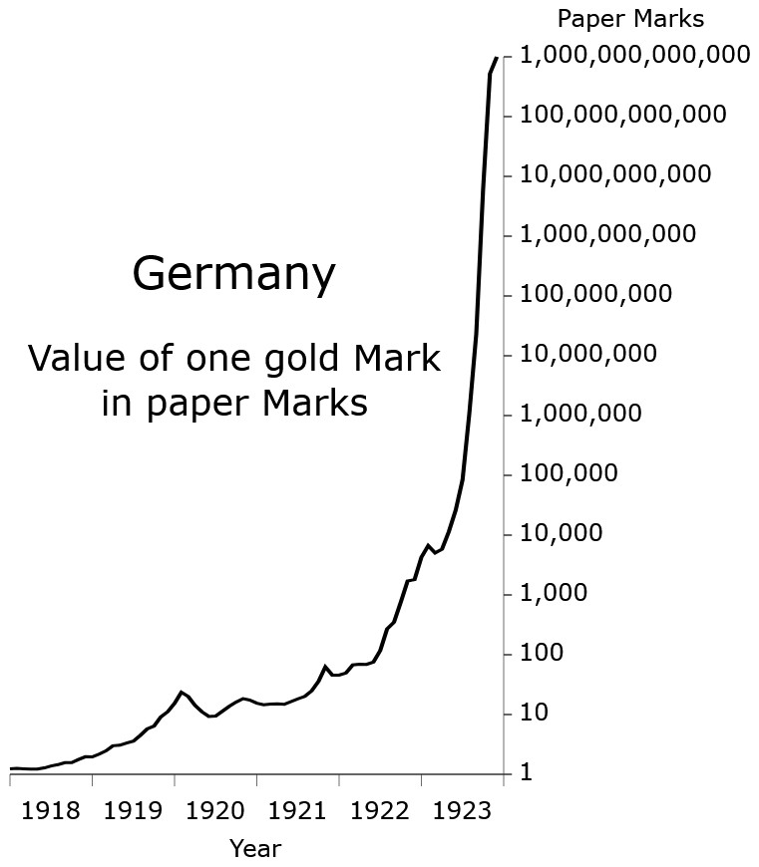
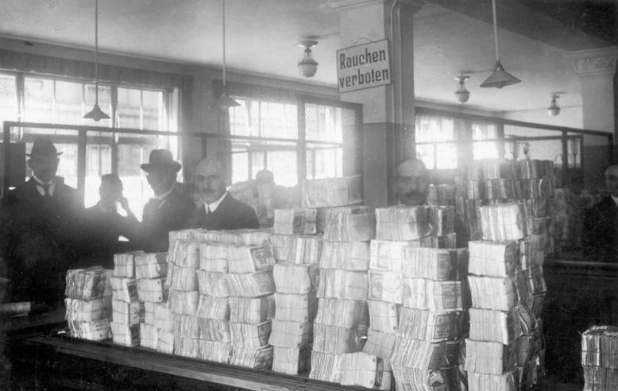
→ A loaf of bread in Berlin cost 160 marks in 1922, but 200 billion marks in 1923
→ Hungary 1940s – 41.9 quadrillion percent inflation
→ Zimbabwe 2000s – 89.7 sextillion percent inflation

Slide 52
“Words without thoughts never to heaven go” (Hamlet, Act 3, Scene 3)

Slide 53
→ integrate multiple assessment methods to cater to varied learning styles and reduce over-reliance on a singular approach
→ shift focus towards real-world problem solving, applying knowledge in tangible scenarios
→ promote Academic Integrity, ensure that the essence of a student’s original thought remains intact and authentic
→ embrace AI as a learning partner
→ prioritise soft skills in assessments
→ prioritise feedback over grades
(Chan & Colloton, 2024, p. 94)

Slide 54


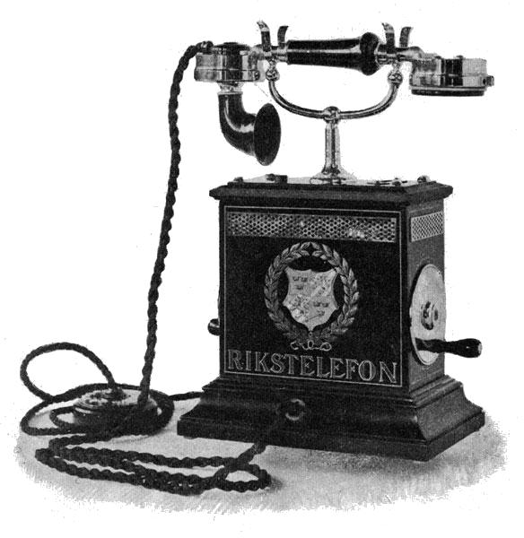

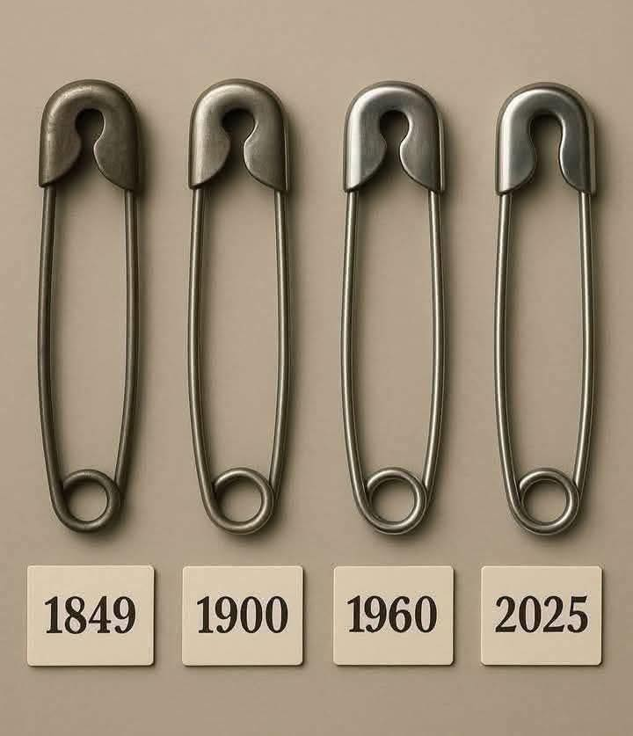

1876
1896
1928
1972

Slide 55
→ integrate multiple assessment methods to cater to varied learning styles and reduce over-reliance on a singular approach
→ shift focus towards real-world problem solving, applying knowledge in tangible scenarios
→ promote Academic Integrity, ensure that the essence of a student’s original thought remains intact and authentic
→ embrace AI as a learning partner
→ prioritise soft skills in assessments
→ prioritise feedback over grades
(Chan & Colloton, 2024, p. 94)

Slide 56
Dear Professor,
I hope you are doing well.
Thank you very much for your feedback on the previously proposed topics. I have carefully considered your comments, particularly regarding the feasibility and methodological requirements of the earlier ideas.
Based on your guidance, I have now revised my approach and selected three new dissertation topics that are primarily literature-based and analytical in nature, and do not require primary data collection or complex empirical methodologies. These topics focus on real-world business problems and allow for critical evaluation through existing academic research and business case studies.
I have attached the revised topics document for your review.
I would be grateful for your feedback on whether any of these topics are suitable to proceed with. Additionally, if you would prefer to suggest a specific topic or research area that you feel would be more appropriate for my dissertation, I would be very happy to work on that as well.
Thank you again for your time and support.
Kind regards

Slide 57
Hi . . .,
Can you please NOT use generative AI to write your messages?
In my previous email I advised you to think in terms of the variables you'll be measuring and participants you will need to recruit. You ignored my feedback and sent me another AI-generated document with some vague research ideas, not referring to the variables, data collection tools, or recruitment of respondents. I'm afraid we won't get far this way. If you're not willing to do any work, beyond using generative AI, you're on a clear path not only to fail, but also to facing academic misconduct procedure.
If you want to talk about your research, I'm available for a Teams video call this afternoon.
Sir I want to talk with you about my topic research am bit confused how I can connect with you on team video

Slide 58
→ integrate multiple assessment methods to cater to varied learning styles and reduce over-reliance on a singular approach
→ shift focus towards real-world problem solving, applying knowledge in tangible scenarios
→ promote Academic Integrity, ensure that the essence of a student’s original thought remains intact and authentic
→ embrace AI as a learning partner
→ prioritise soft skills in assessments
→ prioritise feedback over grades
(Chan & Colloton, 2024, p. 94)

Slide 59
→ integrate multiple assessment methods to cater to varied learning styles and reduce over-reliance on a singular approach
→ shift focus towards real-world problem solving, applying knowledge in tangible scenarios
→ promote Academic Integrity, ensure that the essence of a student’s original thought remains intact and authentic
→ embrace AI as a learning partner
→ prioritise soft skills in assessments
→ prioritise feedback over grades
(Chan & Colloton, 2024, p. 94)

Slide 60

Michael Brenner, Professor of Applied Mathematics in the School of Engineering and Applied Sciences at Harvard
Before I went to lecture, just for fun, I stuck in my problem set into Gemini, and it basically solved everything. I was quite shocked because these are things that people spend their lives learning how to do. But I decided that I would just say to the students, “Well, this now happened. And so my syllabus is now invalid.” And so I completely changed the class. Every week, instead of giving problems to solve I told them that they needed to invent a problem. And if they found the problem that the best chatbot couldn’t solve, they got extra credit. By the end of the semester, we had 600 problems that, for the most part, the best chatbots at the moment couldn’t solve. We as a class wrote a paper about this and it was just published with everybody in the class as authors. In lieu of a final exam, I carried out oral exams. I said, “You’ve invented these 10 problems,” and I picked one — I didn’t let them choose — and I made them go to my blackboard and solve it, then explain to me how they came up with it. I learned more about the students than I ever have in the past in such a class. Subjectively, they knew more than anyone that I’d ever taught before because they were forced to go and read things that they ordinarily wouldn’t need to read because they had to push the state of the art.
Preserving learning in the age of AI shortcuts (Perfas, 2026)

Slide 61
Michael Brenner, Professor of Applied Mathematics in the School of Engineering and Applied Sciences at Harvard
Before I went to lecture, just for fun, I stuck in my problem set into Gemini, and it basically solved everything. I was quite shocked because these are things that people spend their lives learning how to do. But I decided that I would just say to the students, “Well, this now happened. And so my syllabus is now invalid.” And so I completely changed the class. Every week, instead of giving problems to solve I told them that they needed to invent a problem. And if they found the problem that the best chatbot couldn’t solve, they got extra credit. By the end of the semester, we had 600 problems that, for the most part, the best chatbots at the moment couldn’t solve. We as a class wrote a paper about this and it was just published with everybody in the class as authors. In lieu of a final exam, I carried out oral exams. I said, “You’ve invented these 10 problems,” and I picked one — I didn’t let them choose — and I made them go to my blackboard and solve it, then explain to me how they came up with it. I learned more about the students than I ever have in the past in such a class. Subjectively, they knew more than anyone that I’d ever taught before because they were forced to go and read things that they ordinarily wouldn’t need to read because they had to push the state of the art.
Preserving learning in the age of AI shortcuts (Perfas, 2026)

Slide 62
Artificial
Narrow Intelligence
Artificial General Intelligence
Artificial Super Intelligence
“AGI and ASI are still theoretical concepts”
(Chan & Colloton, 2024, pp. 1-2)

Slide 63
A moving target
→ Elizabeth Hollis-Watts: 22 lecturers, 13 institutions, 0 received training related to generative AI, 2 were asked to train others (see also UNESCO, 2023)
→ AI detecting software vs AI humanising software
→ Ethical use of AI
/ critical use of AI
vs silly use of AI

Slide 64
Sebastian.Lesniewski@bil.ac.uk
SebastianLesniewski.com

Slide 65
References
Chan, C. K. Y., & Colloton, T. (2024). Generative AI in higher education: The ChatGPT effect. Routledge. https://doi.org/10.4324/9781003459026
Fiedler, A., & Döpke, J. (2025). Do humans identify AI-generated text better than machines? Evidence based on excerpts from German theses. International Review of Economics Education, 49, 100321. https://doi.org/10.1016/j.iree.2025.100321
Fleckenstein, J., Meyer, J., Jansen, T., Keller, S. D., Köller, O., & Möller, J. (2024). Do teachers spot AI? Evaluating the detectability of AI-generated texts among student essays. Computers and Education: Artificial Intelligence, 6, 100209. https://doi.org/10.1016/j.caeai.2024.100209
Giray, L. (2024). The Problem with False Positives: AI Detection Unfairly Accuses Scholars of AI Plagiarism. The Serials Librarian, 85(5–6), 181–189. https://doi.org/10.1080/0361526X.2024.2433256
Gosling, S. D., Ybarra, K., & Angulo, S. K. (2024). A widely used Generative-AI detector yields zero false positives. Aloma: Revista de Psicologia, Ciències de l'Educació i de l'Esport, 42(2), 31-43. https://doi.org/10.51698/aloma.2024.42.2.31-43
Hyatt, J. P. K., Bienenstock, E. J., Firetto, C. M., Woods, E. R., & Comus, R. C. (2025). Using aggregated AI detector outcomes to eliminate false positives in STEM-student writing. Advances in Physiology Education, 49(2), 486-495. https://doi.org/10.1152/advan.00235.2024
Mukherjee, S. (2023, June 15). Unveiling Perplexity: Measuring Success of LLMs and Generative AI Models. Medium. https://ramblersm.medium.com/the-significance-of-perplexity-in-evaluating-llms-and-generative-ai-62e290e791bc
Tian, E. (2023, March 1). Perplexity, burstiness, and statistical AI detection. GPTZero. https://gptzero.me/news/perplexity-and-burstiness-what-is-it/
Perfas, S. L. (Host). (2026, February 18). Preserving learning in the age of AI shortcuts [Audio podcast episode]. In Harvard Thinking (S1, Ep22). The Harvard Gazette. https://news.harvard.edu/gazette/story/2026/02/preserving-learning-in-the-age-of-ai-shortcuts/
UNESCO (2023, June 1). UNESCO survey: Less than 10% of schools and universities have formal guidance on AI. https://www.unesco.org/en/articles/unesco-survey-less-10-schools-and-universities-have-formal-guidance-ai

